Slide 1

Sound Events Classification using BNNs on Tightly Power-Restricted IoT Devices
Master’s thesis, Final-Presentaion FS2018
Li-Yung Chen
Advisors: Renzo Andri, Lukas Cavigelli, Germain Haugou, Armin Sadighi (TUM)
Supervisors: Prof. Dr. Luca Benini, Prof. Dr. Andreas Herkersdorf (TUM)
Notes:
Exchange student from TUM....
<number>
Implementation and Optimization of BNNs for Embedded Platform and IoT

Slide 2

Outline
Motivation
Introduction
Implementation
Results
Conclusion
Photo Credit: Li-Yung Chen, 2. Place in Photo Competition at ETH Zurich
Li-Yung Chen
9/21/18
<number>
Notes:
Implementation and Optimization of BNNs for Embedded Platform and IoT
<number>

Slide 3

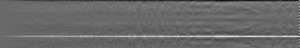

Motivation
Novel Applications based on DNNs.
Raw sound data
Cloud
Sound
Sound Preprocessing
IoT Devices
DNN
Result: bird
Li-Yung Chen
9/21/18
<number>
Notes:
Typical novel applications on IoT or mobile devices: send data to cloud
Number of device → loading for cloud servers
Latency → even no internet available → not good for real-time application
+keywords: latency, number of device
<number>
Implementation and Optimization of BNNs for Embedded Platform and IoT

Slide 4
Motivation
Edge Computing for IoT: Avoid data transmission
Raw sound data
Cloud
Sound
Sound Preprocessing
IoT Devices
DNN
Result: bird
Li-Yung Chen
9/21/18
<number>
Notes:
Latency, internet not available, privacy
the volume of data that can be transferred.
Also less security concern for transmission
the volume of data that can be transferred.
<number>
Implementation and Optimization of BNNs for Embedded Platform and IoT

Slide 5
Motivation
DNNs: High Computational Effort
IoT Devices
Sound
Result: bird
Sound
Preprocessing
Li-Yung Chen
9/21/18
<number>
Notes:
When moving to device, the problem is still there. DNN
require high computational effort
One propose BNN to address this issue
<number>
Implementation and Optimization of BNNs for Embedded Platform and IoT

Slide 6
Motivation
BNNs[1][2]: Reducing computational complexity
IoT Devices
1
-
Sound
1
1
Result: bird
1
1
-
1
Sound
Preprocessing
-
-
1
1
To investigate the performance of
sound detection using BNNs
Li-Yung Chen
9/21/18
<number>
Notes:
When moving to device, the problem is still there. DNN
require high computational effort
One propose BNN to address this issue
We would like to see how the performance on the state of the art IoT processor GAP8 is
<number>
Implementation and Optimization of BNNs for Embedded Platform and IoT

Slide 7
Outline
Motivation
Introduction
Implementation
Results
Conclusion
Photo Credit: Li-Yung Chen, 2. Place in Photo Competition at ETH Zurich
Li-Yung Chen
9/21/18
<number>

Slide 8

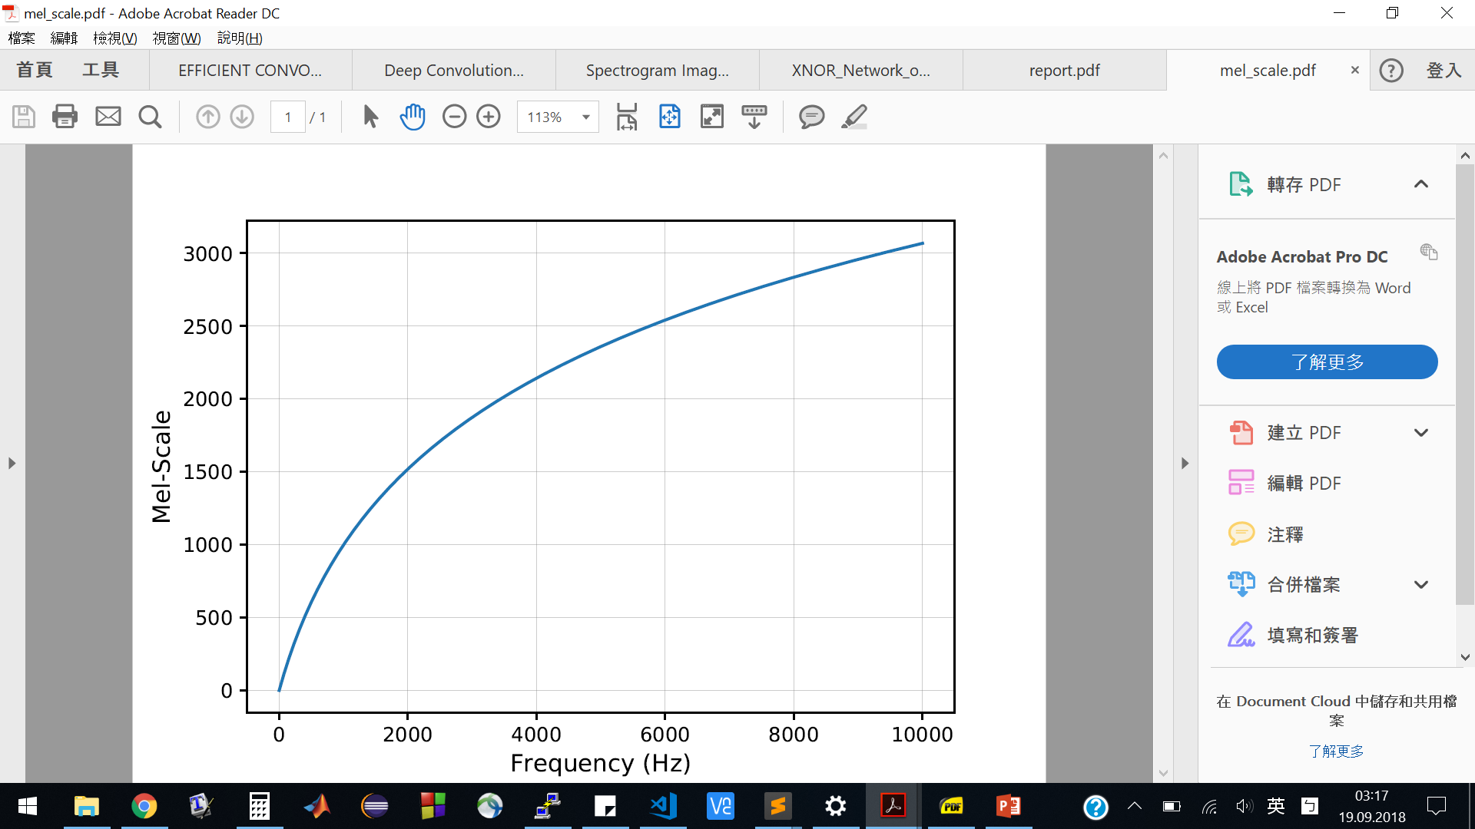
Introduction: Sound Preprocessing (MFCC)
Mel-Frequency Cepstrum Coefficients
Mimic Human Auditory System
100 Hz
: Different Sound
200 Hz
14000 Hz
: Same Sound
14100 Hz
Mel-Scale
Li-Yung Chen
9/21/18
<number>
Notes:
For deep learning, the most important thing is the number of data and features extraction
Implementation and Optimization of BNNs for Embedded Platform and IoT
<number>

Slide 9
Introduction: Binary Neural Networks
[Mallat, 2012]
[Courbariaux, 2016]
[Rastegari, 2016]
Binary Neural Networks (BNN)
Full-Precision DNN
2
1
-3
-1
3
-1
-1
-1
2
-4
Input
Input
-3
1
1
-3
2
-1
-1
-2
Weights
Output
Weights
Output
2x(-3) + 3x(-1) + (-3)x(-3) + (-2)x2 = -4
1x(-1) + (-1)x(-1) + 1x1 + (-1)x(-1) = 2
Li-Yung Chen
9/21/18
<number>
Notes:
animation
Implementation and Optimization of BNNs for Embedded Platform and IoT
<number>

Slide 10
Introduction: Binary Neural Networks
[Mallat, 2012]
→ XOR + Popcount
Binary Neural Networks
Input | Weights | Output
-1 | -1 | 1
-1 | 1 | -1
1 | -1 | -1
1 | 1 | 1
Input | Weights | Output
1 | 1 | 0
1 | 0 | 1
0 | 1 | 1
0 | 0 | 0
→
XOR
Li-Yung Chen
9/21/18
<number>
Notes:
Mapping to xor
1 bit can only store 0 and 1,
-1 decimal → 0 in binary : need conversion
Implementation and Optimization of BNNs for Embedded Platform and IoT
<number>

Slide 11
Introduction: Binary Neural Networks
[Mallat, 2012]
[Courbariaux, 2016]
[Rastegari, 2016]
Binary Neural Networks → XOR + Popcount
1
0
-1
1
-1
-1
1
1
2
2
Input
Input
1
1
0
0
-1
-1
1
1
Weights
Output
Weights
Output
0 xor 1 = 1
1 xor 1 = 0
0 xor 0 = 0
1 xor 1 = 0
mapping
1 + 0 + 0 + 0 = 1
1x(-1) + (-1)x(-1) + 1x1 + (-1)x(-1) = 2
=>
=> 2
(I xor W = Out)
Li-Yung Chen
9/21/18
<number>
Notes:
Animation
Because I already map to 0 and 1 .
Need to map the result back to
Implementation and Optimization of BNNs for Embedded Platform and IoT
<number>

Slide 12
Introduction: Binary Neural Networks
[Mallat, 2012]
[Courbariaux, 2016]
[Rastegari, 2016]
Binary Neural Networks → XOR + Popcount
Smaller Model Size
Bit-Level Parallelization
Popcount (HW instruction): Accumulation of number of „1“
0 1 1
1 1 0
0 0 0
1 1 0
4-bit
mapping
4-bit
xor
=
=>
1 + 0 + 0 + 0 = 1 => 2
popcount
(I xor W = Out)
Li-Yung Chen
9/21/18
<number>
Notes:
Popcount some architecture has pocount instruction → accelerate
Implementation and Optimization of BNNs for Embedded Platform and IoT
<number>

Slide 13

Contributions
[Mallat, 2012]
My Contributions:
GAPUINO Board
ARM / PULP
Integration and optimization of MFCCs preprocessing
Sound Preprocessing
(MFCCs Features)
Existing:
BNN on ARM [3]
BNN on PULP
(Fulmine) [4]
Optimization of BNNs on GAP8
BNN Inference
Completion of the whole processing flow
Output Results
Baseline optimization on ARM
Li-Yung Chen
9/21/18
<number>
Notes:
Training (different MFCCs features)
Implementation and Optimization of BNNs for Embedded Platform and IoT
<number>

Slide 14
Outline
Motivation
Introduction
Implementation
Results
Conclusion
Photo Credit: Li-Yung Chen, 2. Place in Photo Competition at ETH Zurich
Li-Yung Chen
9/21/18
<number>

Slide 15
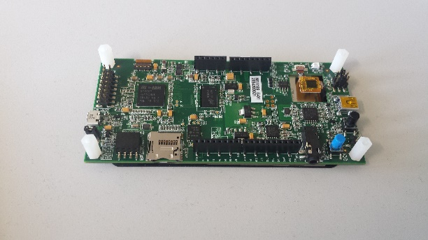
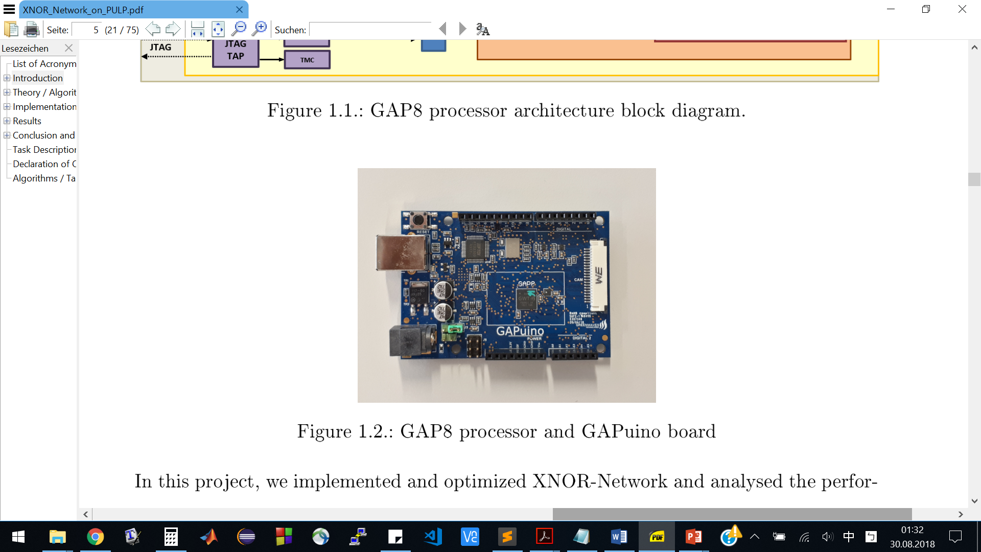
Implementation: Platforms
Baseline
Target
 | STM32F469 | GAPuino
Architecture | ARM Cortex-M4 | Extended RISC-V
Core(s) | 1 | 8+1(Fabric Controller)
SRAM/ L1 Memory | 384 kBytes | 64 kBytes
Frequency | Max. 180 M Hz | Max. 250 M Hz
FPU | Yes | No
Built-in popcount | No | Yes
Li-Yung Chen
9/21/18
<number>
Notes:
Implementation and Optimization of BNNs for Embedded Platform and IoT
<number>

Slide 16
Implementation: Dataset & Training
[Mallat, 2012]
Network Architecture[3][4]
Acoustic Event Dataset
28 Classes
BNNs Training
Top-1 Accuracy: 63%
Sound Samples
Full-Pre. Conv.
MFCC Features
Batch Norm.
First Layer
ReLu
Binary Conv.
1. Binary Layer
Scaling
Batch Norm.
2. Binary Layer
Binarize
ReLu
3. Binary Layer
Batch Norm.
Binary Conv.
4. Binary Layer
Scaling
Binarize
Last Layer
ReLu
Average Pool
Batch Norm.
LogSoftMax
Full-Pre. Conv.
Results
Li-Yung Chen
9/21/18
<number>
Notes:
To do a sound events classfication, we need model data.
Need data
Need preprocessing
Implementation and Optimization of BNNs for Embedded Platform and IoT
<number>

Slide 17

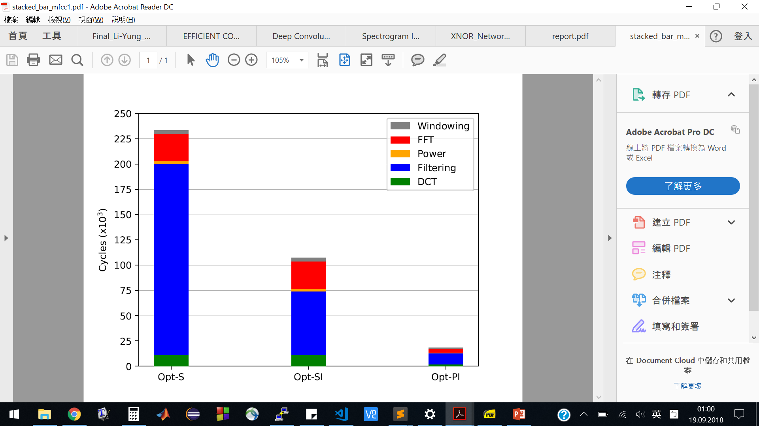
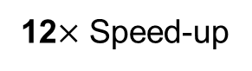
Implementation: Sound Preprocessing (MFCC)
Amplitude
Optimization on GAP8 (Fixed-point)
Simple Implementation (Opt-S)
Integer square root (Filtering) (Opt-SI)
8 cores Parallelization (Opt-PI)
Time
32ms
12 Speed-up
Li-Yung Chen
9/21/18
<number>
Notes:
Once having model
Preprocessing is missing on board
Implementation and Optimization of BNNs for Embedded Platform and IoT
<number>

Slide 18
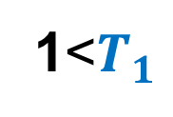
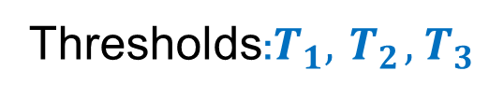
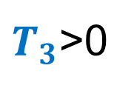
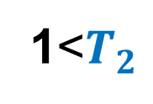
Implementation: BNNs Optimization
BNNs Optimization on runtime (inference)
0 1 1
1 1 0
0 0 0
1 1 0
4-bit
xor
=
(1 + 0 + 0 + 0) = 1
Binary Conv.
=>
1. Binary Layer
Scaling
popcount
ReLu
Batch Norm.
4-bit
Binarize
no
yes
Output: 1 or 0
1<
Thresholds:
no
>0
yes
no
1<
yes
Output:
0
1
0
1
Li-Yung Chen
9/21/18
<number>
Notes:
Threshold in memory, no calculation on runtime
Comparing: generate output feature
Implementation and Optimization of BNNs for Embedded Platform and IoT
<number>

Slide 19
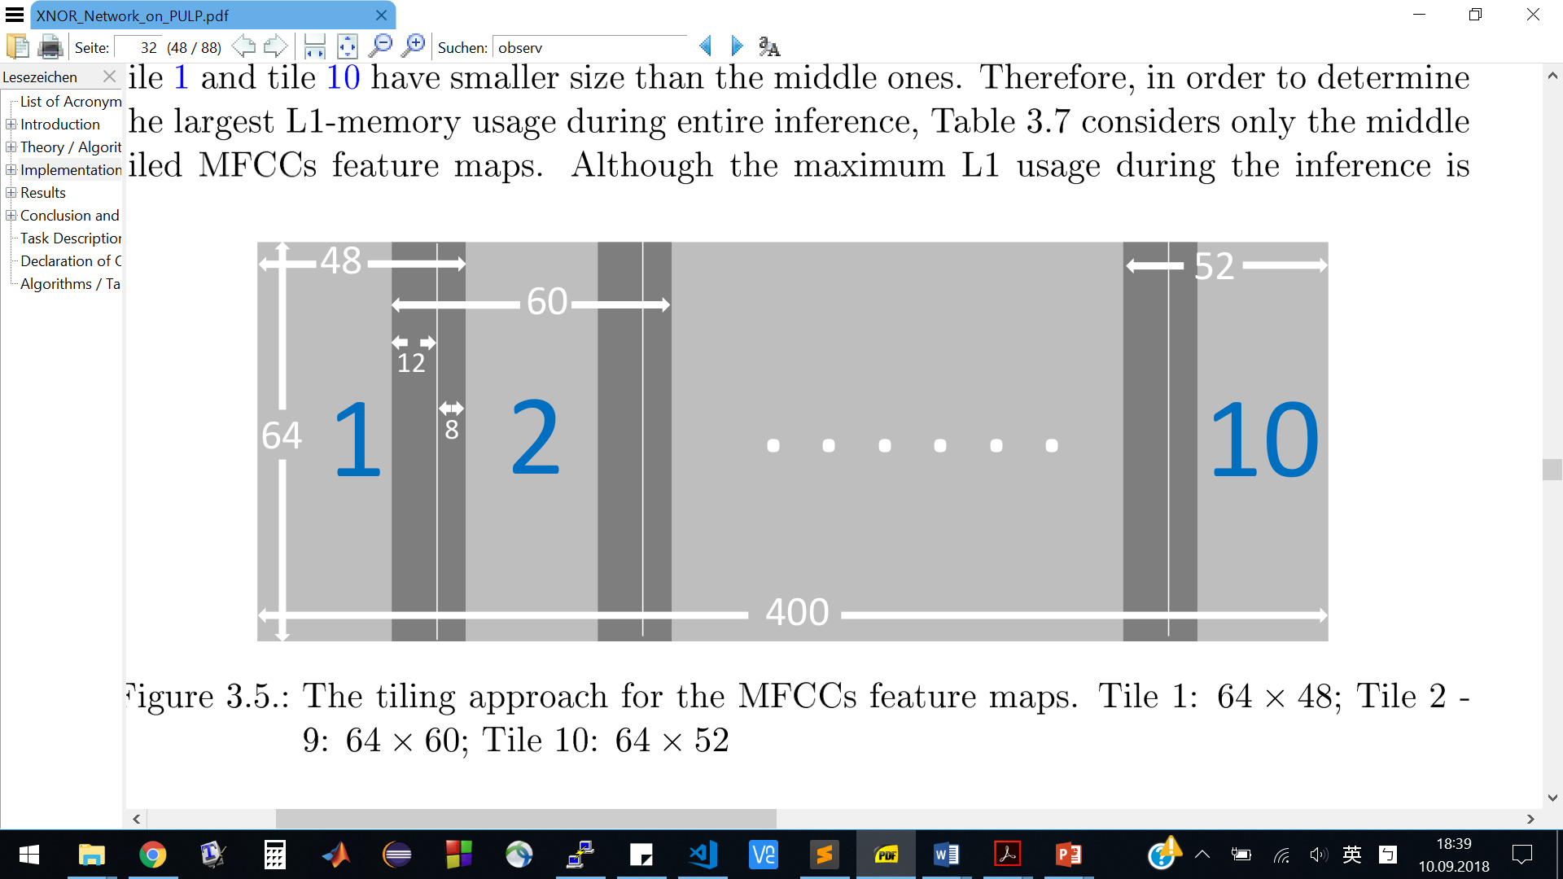
Implementation: BNNs on ARM and GAP8
BNNs on STM32F469NI MCU (ARM Cortex-M4)
Instruction-level optimization
for loops unrolling
inline function
restrict pointer
BNNs on GAP8
Optimizing BNNs from Fulmine to GAP8
8 cores parallelization (OpenMP)
Memory management (L1: 64 kB)
Input: 100 kB
Li-Yung Chen
9/21/18
<number>
Notes:
GAP8:
Implementation and Optimization of BNNs for Embedded Platform and IoT
<number>

Slide 20
Outline
Motivation
Introduction
Implementation
Results
Conclusion
Photo Credit: Li-Yung Chen, 2. Place in Photo Competition at ETH Zurich
Li-Yung Chen
9/21/18
<number>

Slide 21
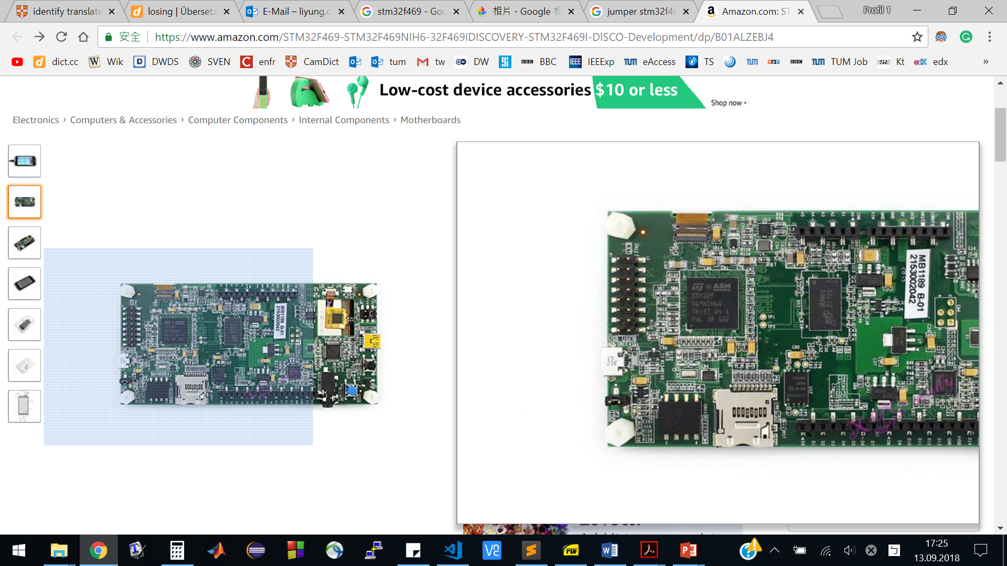
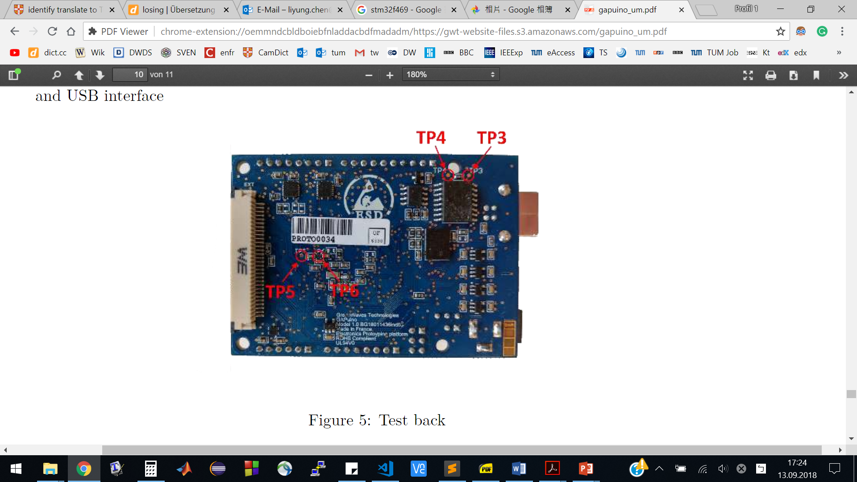
Results: Power Measurement
STM32F469NI Board:
Current for MCU (3.3V):
GAPUNIO Board:
Current for GAP8 (2.8V):
Li-Yung Chen
9/21/18
<number>
Notes:
Provide convenient ways for measuring only MCU.
Power of ther Peripherals are excluded
<number>
Implementation and Optimization of BNNs for Embedded Platform and IoT

Slide 22
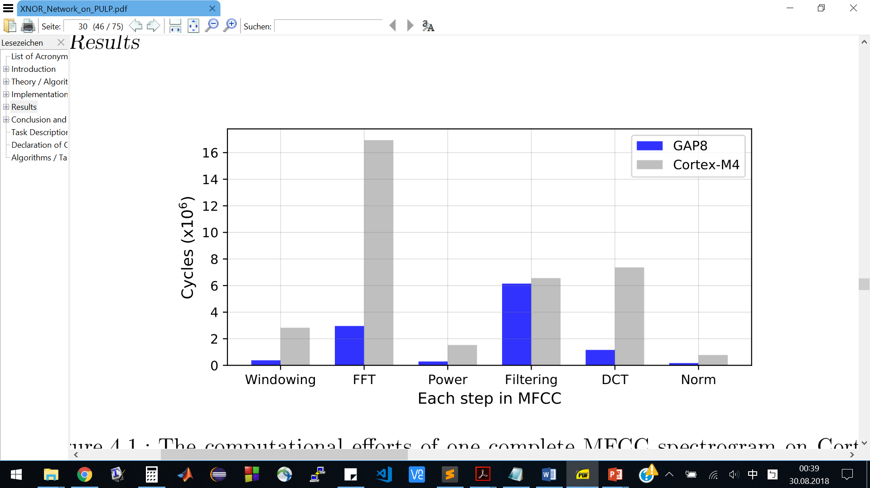
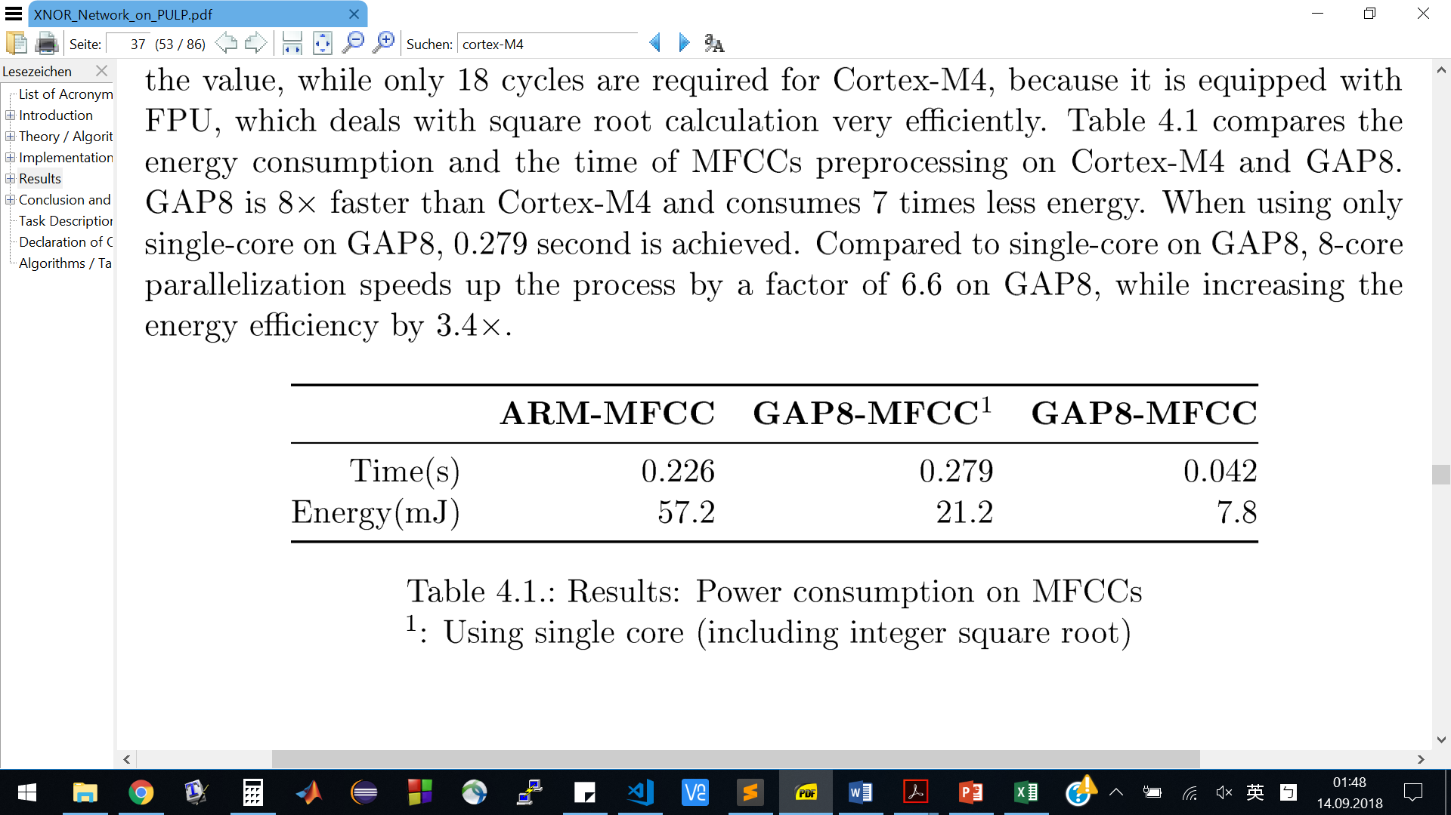
Results: MFCCs Preprocessing
Duration and Energy of the MFCCs Preprocessing
Preprocessing 3.2 seconds recording on GAP8 and ARM
5.3x faster
7.3x less energy
Li-Yung Chen
9/21/18
<number>
Notes:
ARM vs Single core vs 8 cores
Filtering: similar, caused by integer square root
Single core (including isqrt)
<number>
Implementation and Optimization of BNNs for Embedded Platform and IoT

Slide 23
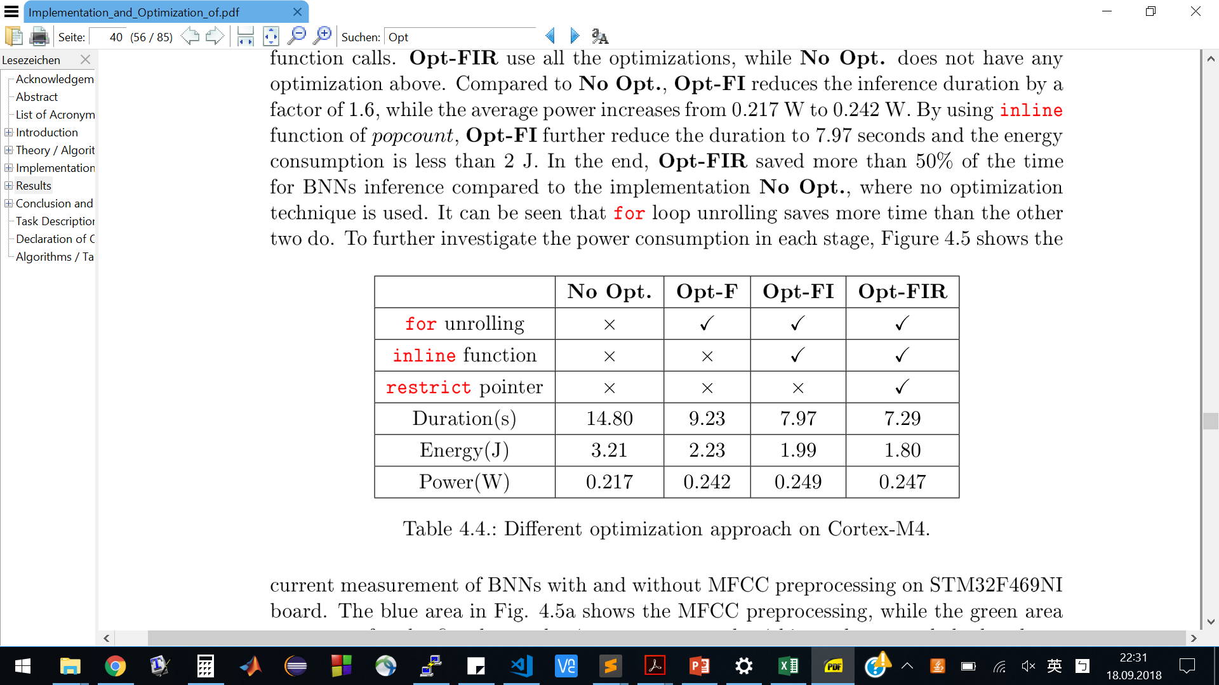
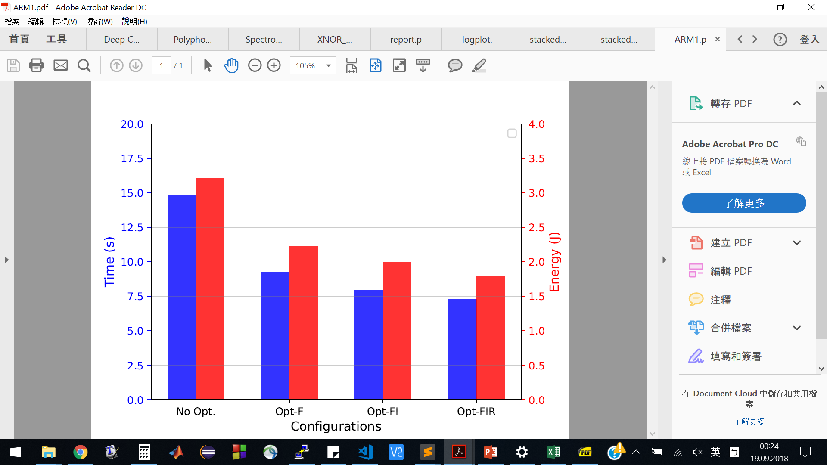
Results: BNNs Optimization on ARM (Baseline)
BNNs Inference on ARM
No Opt: Baseline
Opt-F: for unrolling
Opt-FI: for unrolling + inline function
Opt-FIR: for unrolling + inline function + restrict pointer
2x faster
1.8x less energy
Li-Yung Chen
9/21/18
<number>
Notes:
For unrolling
Inline for popcount
Parallelization
Q8.20 vs Q8.0 , slight improvement
<number>
Implementation and Optimization of BNNs for Embedded Platform and IoT

Slide 24
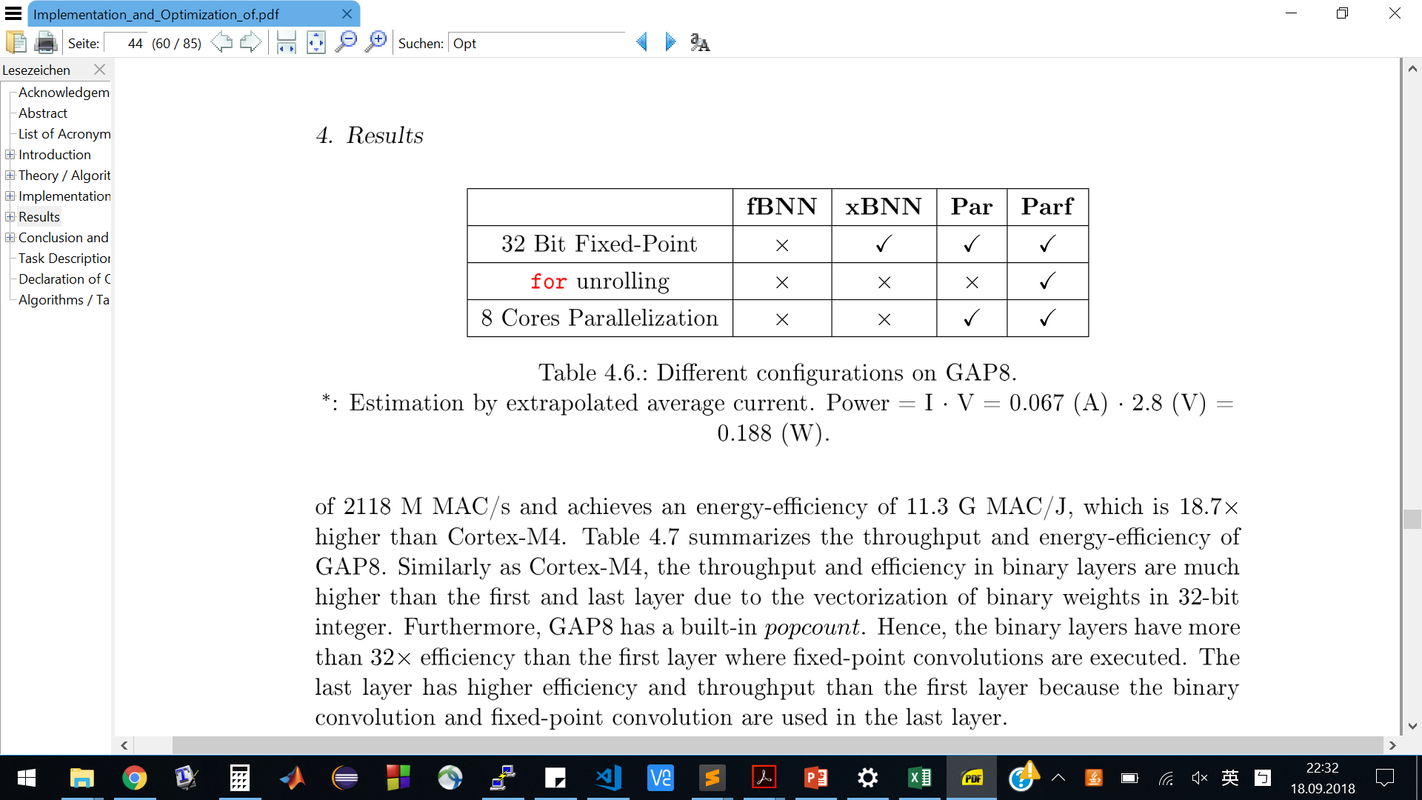
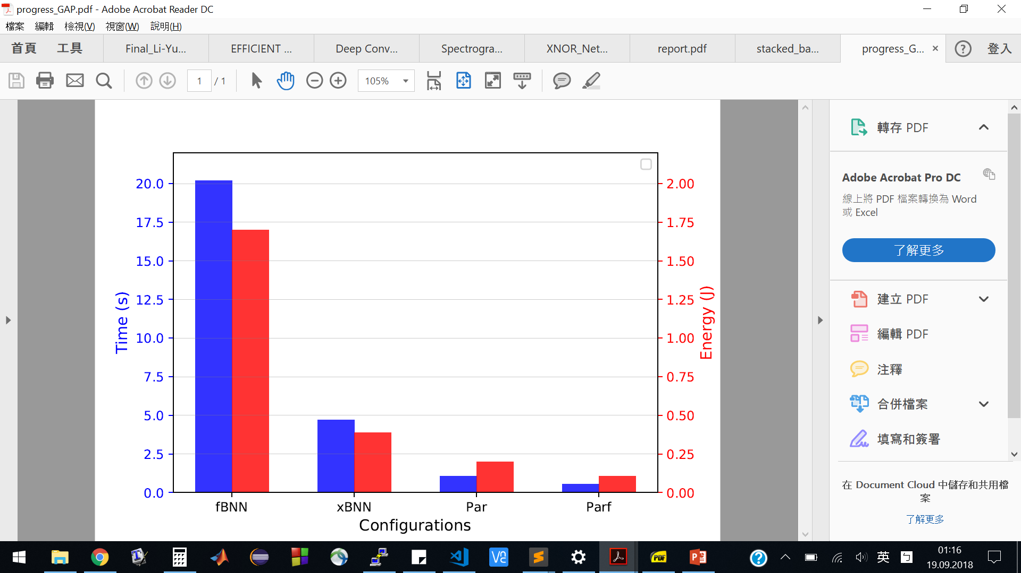
Results: BNNs Optimization on GAP8
BNNs Inference on GAP8
fBNN: Floating-point (first layer, last layer)
xBNN: Fixed-point
Par: xBNN + 8 cores Parallelization
Parf: : xBNN + 8 cores Parallelization + for loops unrolling
4x faster
4x less energy
Li-Yung Chen
9/21/18
<number>
Notes:
Restrict, no inline for popcount
Float: slow
For unrolling
Parallelization
Q8.20 vs Q8.0 , slight improvement
<number>
Implementation and Optimization of BNNs for Embedded Platform and IoT

Slide 25
Results: BNNs Optimization on GAP8
BNNs Inference on GAP8
fBNN: Floating-point (first layer, last layer)
xBNN: Fixed-point
Par: xBNN + 8 cores Parallelization
Parf: : xBNN + 8 cores Parallelization + for loops unrolling
8x faster
3.8x less energy
Li-Yung Chen
9/21/18
<number>
Notes:
Restrict, no inline for popcount
Float: slow
For unrolling
Parallelization
Q8.20 vs Q8.0 , slight improvement
<number>
Implementation and Optimization of BNNs for Embedded Platform and IoT

Slide 26
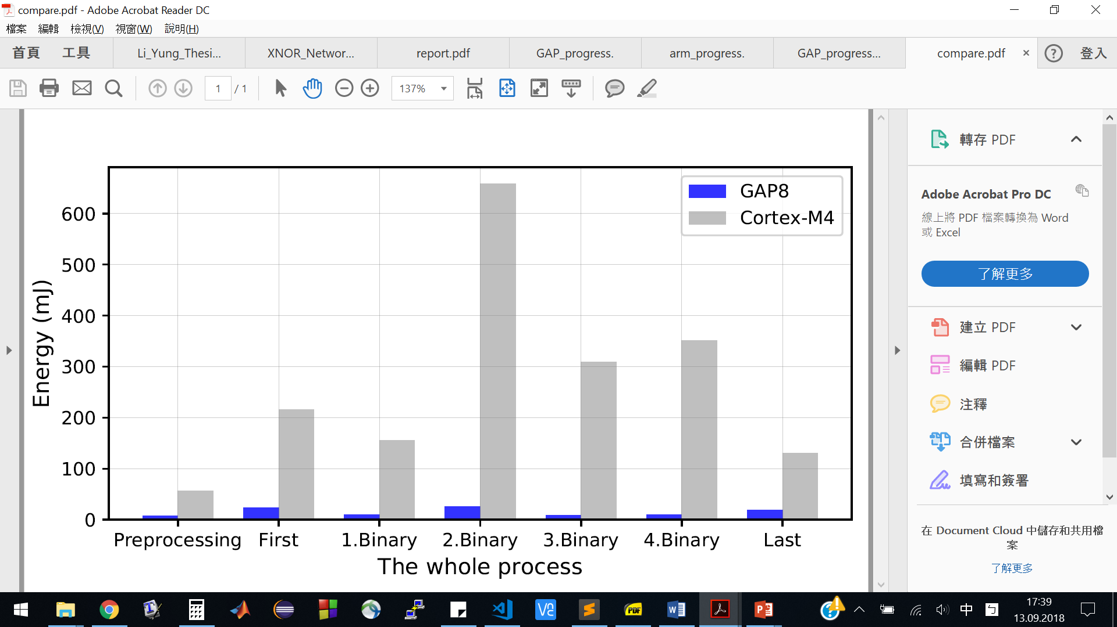
Results: Comparing ARM and GAP8
Energy Consumption (Sound Preprocessing + BNNs)
Comparison : Optimized ARM Cortex-M4 and GAP8
 | Cortex-M4 | GAP8
Duration (s) | 7.53 | 0.562
Energy (mJ) | 1877 | 105
13x faster
18x less energy
Li-Yung Chen
9/21/18
<number>
Notes:
Considering the most optimization:
GAP8: mor efficient on binary layers
CortexM4: efficient on MFCC, first and last layer
Apple with apple please!!(done
<number>
Implementation and Optimization of BNNs for Embedded Platform and IoT

Slide 27
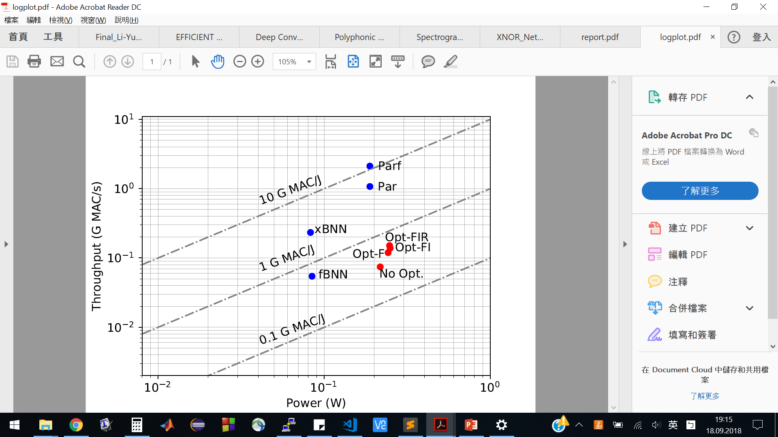
Results: Energy Efficiency
One order of magnitude more energy-efficient
18x higher
efficiency
GAP8 Processor
Cortex-M4
Li-Yung Chen
9/21/18
<number>
Notes:
ARM: power is similar
GAP8: The power increase when 8 core used.
Mention MAC/J (what is MAC?
<number>
Implementation and Optimization of BNNs for Embedded Platform and IoT

Slide 28
Outline
Motivation
Introduction
Implementation
Results
Conclusion
Photo Credit: Li-Yung Chen, 2. Place in Photo Competition at ETH Zurich
Li-Yung Chen
9/21/18
<number>

Slide 29
Conclusion
The application is 13x faster on GAP8 than ARM platform.
18x higher energy-efficiency on GAP8.
Whole process from raw data to classification is completed.
Future Works:
Model data for 16-bit needs retraining with regularization.
Using Convolution-Accelerator for fixed-point conv. layers.
Li-Yung Chen
9/21/18
<number>

Slide 30
On-Board Demo
Photo Credit: Li-Yung Chen, 2. Place in Photo Competition at ETH Zurich
Li-Yung Chen
9/21/18
<number>
Notes:
Implementation and Optimization of BNNs for Embedded Platform and IoT
<number>

Slide 31
[1] M. Courbariaux et al 2016, Binarized Neural Networks: Training deep neural networks with weight and activations constrained to 1 or -1.
[2] M. Rastegari et al 2016, XNOR-Net: ImageNet classification using binary convolutional neural networks.
[3] A. Cramariuc 2016, XNOR Networks for Embedded Systems
[4] R. Glauser 2017, XNOR-Network on PULP
Is there any question?
Photo Credit: Li-Yung Chen, 2. Place in Photo Competition at ETH Zurich
Li-Yung Chen
9/21/18
<number>
Notes:
Implementation and Optimization of BNNs for Embedded Platform and IoT
<number>

Slide 32
Algorithm: Fast Integer Square Root
short int isqrt(unsigned int a)
{
int g = 0x8000;
int c = 0x8000;
for(;;)
{
if(g*g>a)
{
g ^= c;
}
c >>= 1;
if(c == 0)
{
return g;
}
g |= c;
}
}
Li-Yung Chen
9/21/18
<number>
Notes:
double sqrt is expensive
not efficient for GAP8 without FPU
Implementation and Optimization of BNNs for Embedded Platform and IoT
<number>

Slide 33
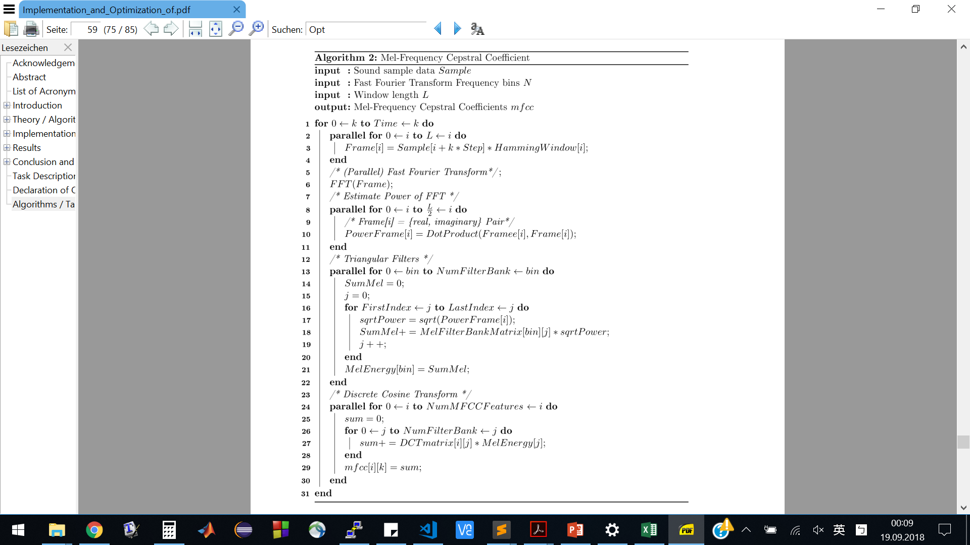
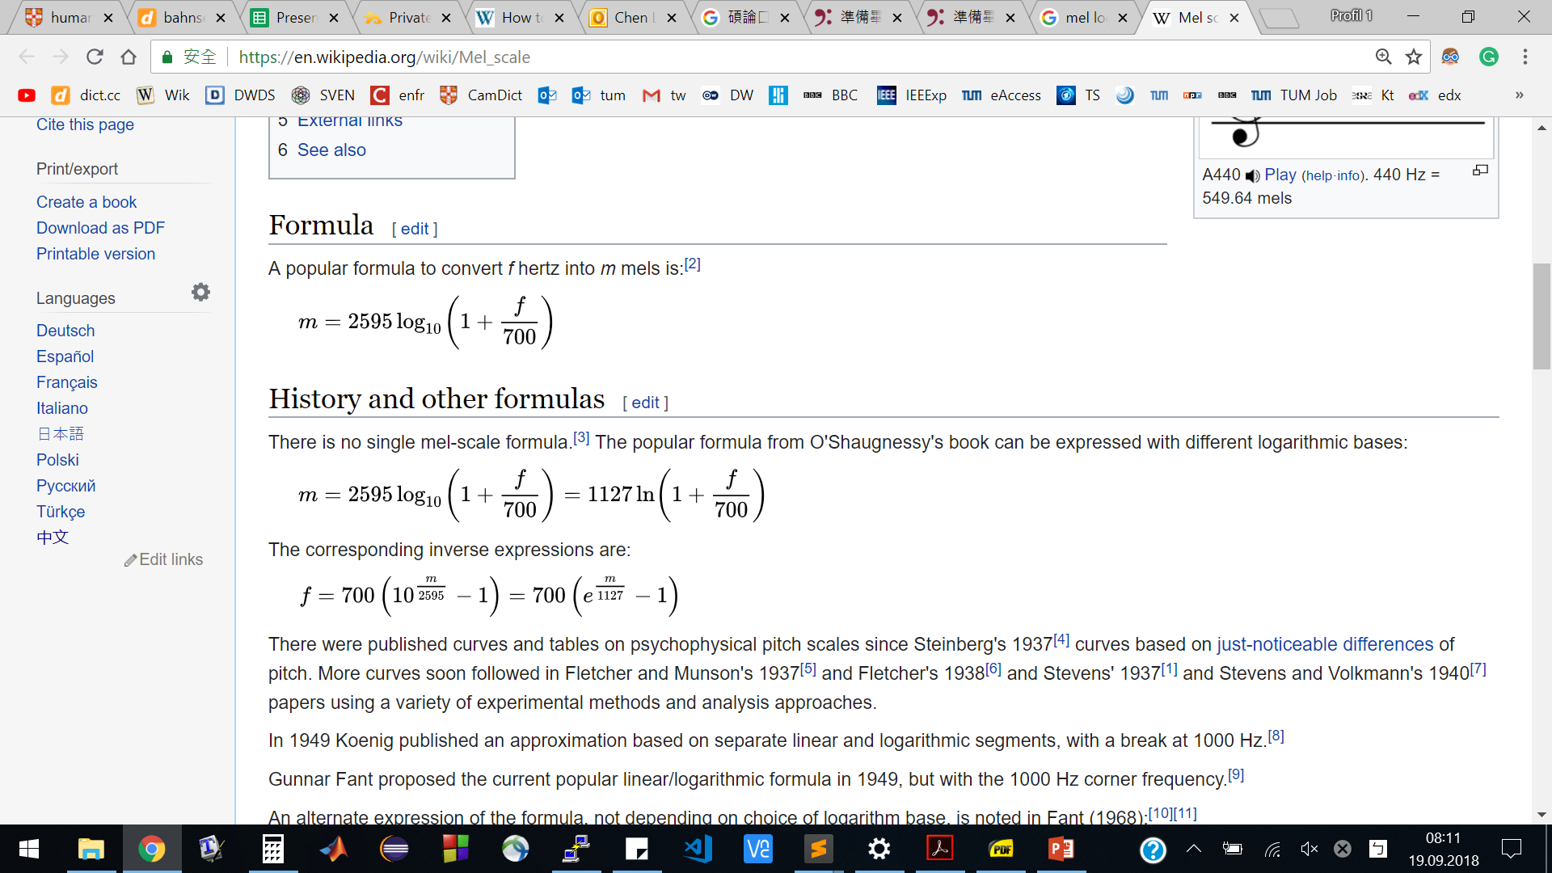
Algorithm: MFCCs Preprocessing
Li-Yung Chen
9/21/18
<number>
Notes:
double sqrt is expensive
not efficient for GAP8 without FPU
Implementation and Optimization of BNNs for Embedded Platform and IoT
<number>

Slide 34
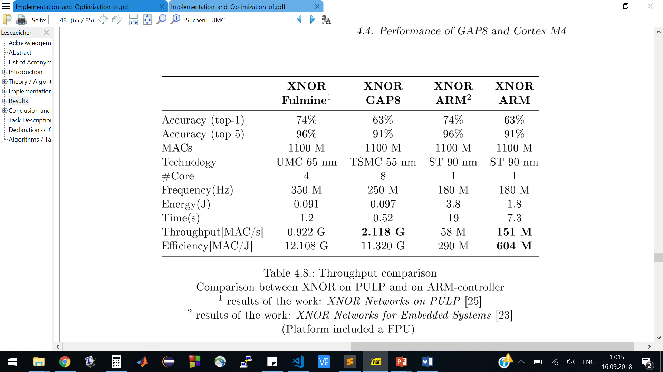
Results
Comparison:
Li-Yung Chen
9/21/18
<number>
Notes:
2.3x faster Fulmine
tiles, 5, 10, 4, 4
Accuracy: different MFCCs features
<number>
Implementation and Optimization of BNNs for Embedded Platform and IoT

Slide 35
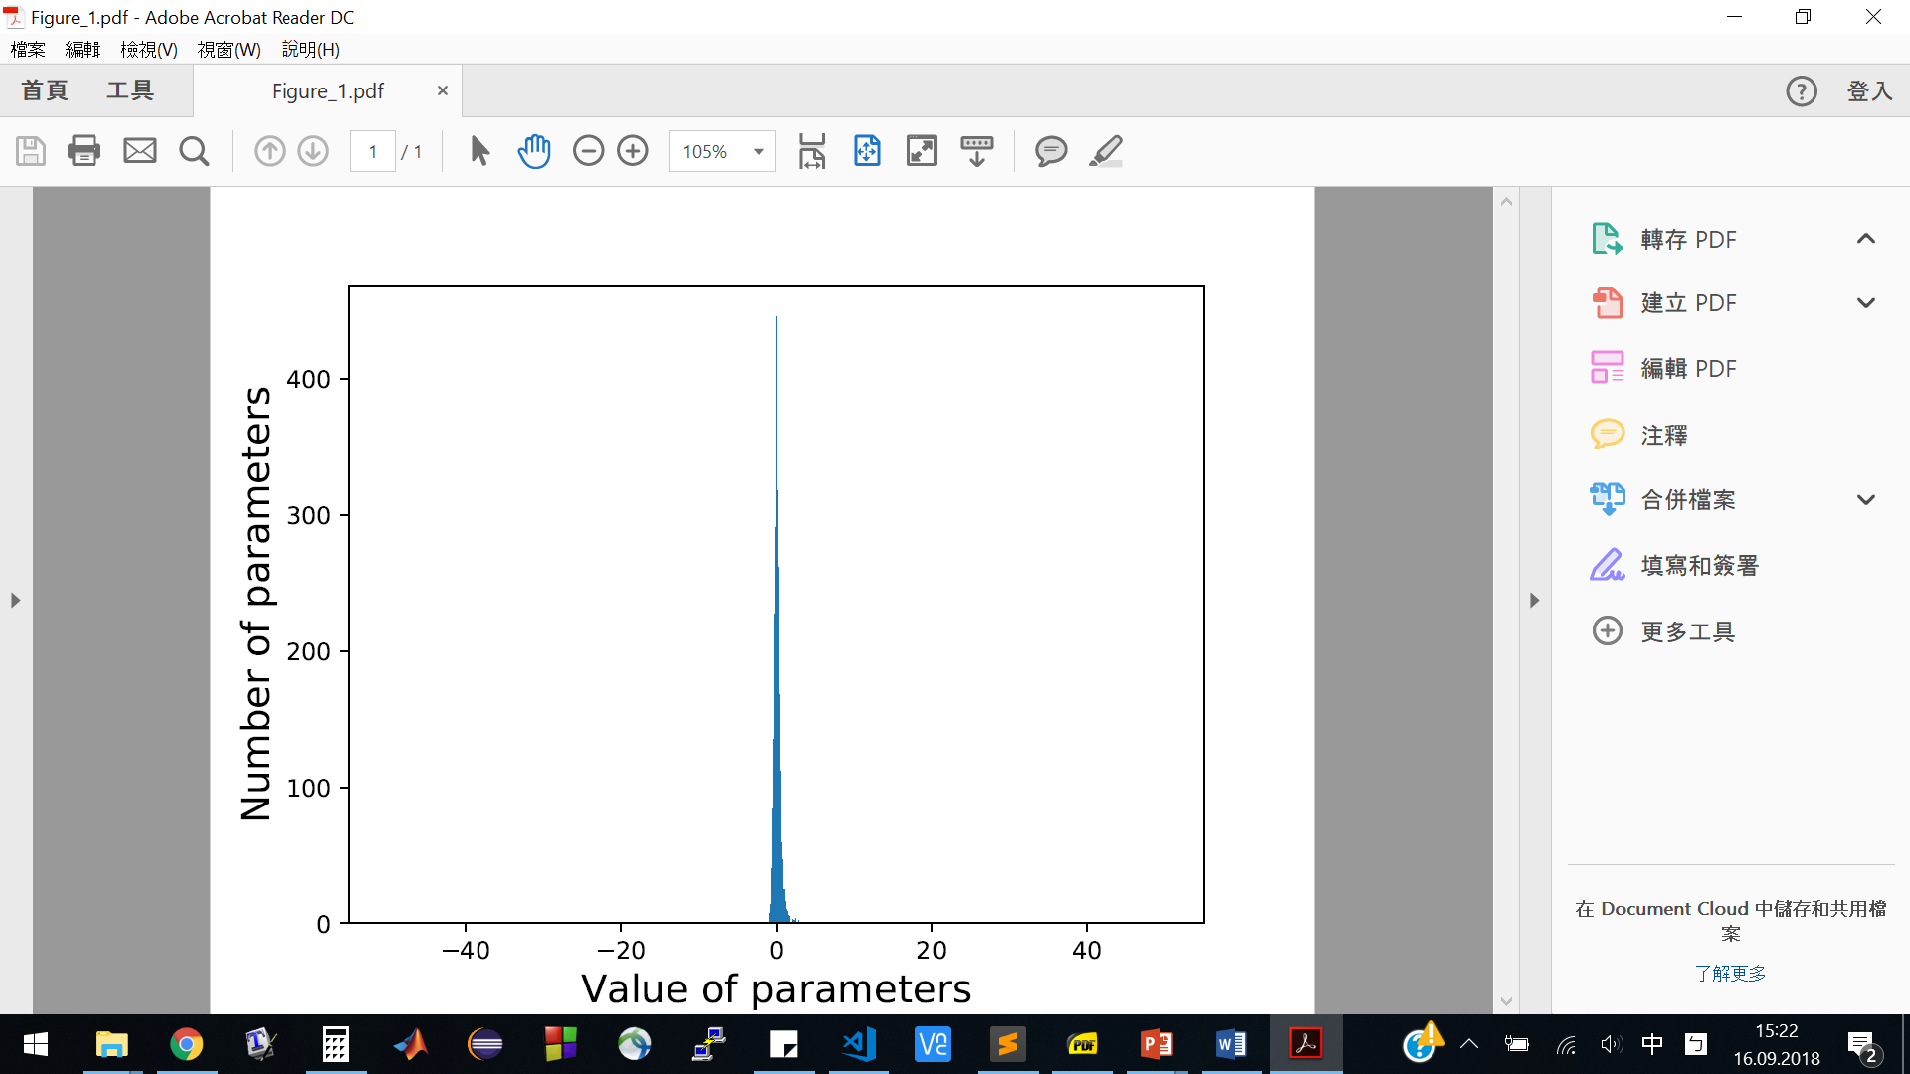
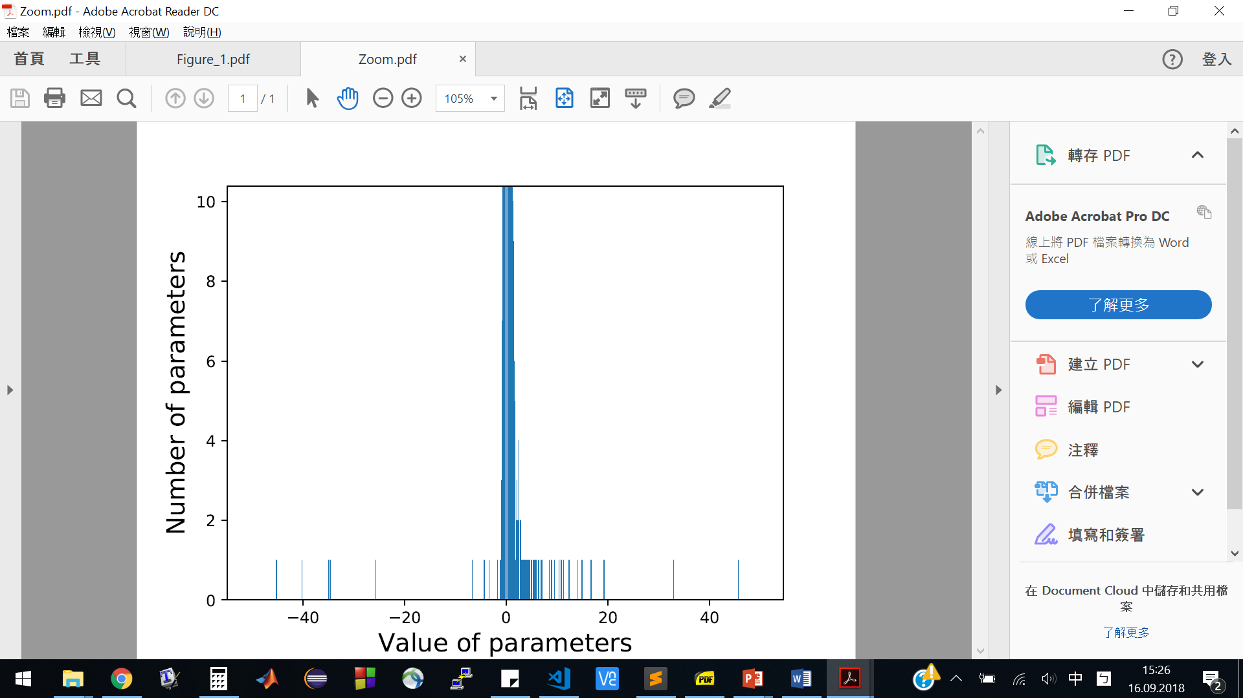
Implementation: Trained Model
Analysis of the Trained Model
5000 float data point (first layer, last layer)
Range [-44, 46]
7 bit for integer parts.
Quantizing float model to 16-bit → Accuracy could degrade
Li-Yung Chen
9/21/18
<number>
Notes:
Can it be compressed 16 bit??
Mostly near 0,
If the range can be regularized to [-8,7]
Implementation and Optimization of BNNs for Embedded Platform and IoT
<number>

Slide 36
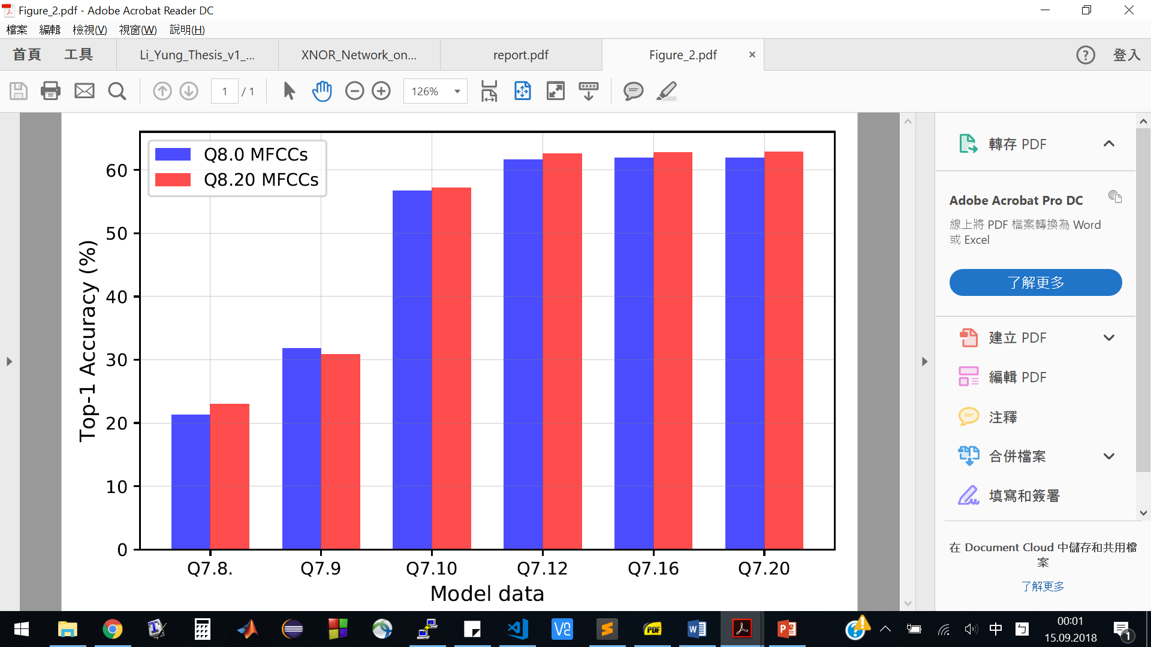
Implementation: Low-Resolution MFCCs
Accuracy vs Model Resolution
Testing MFCC: Q8.0 and Q8.20
Full-precision: Top-1 62.95%
16-bit
Li-Yung Chen
9/21/18
<number>
Notes:
There is no huge difference for Q8.0 and Q8.20 MFCC but model resolution matters
Fractional bits decrease→accuracy decreases.
<number>
Implementation and Optimization of BNNs for Embedded Platform and IoT

Slide 37
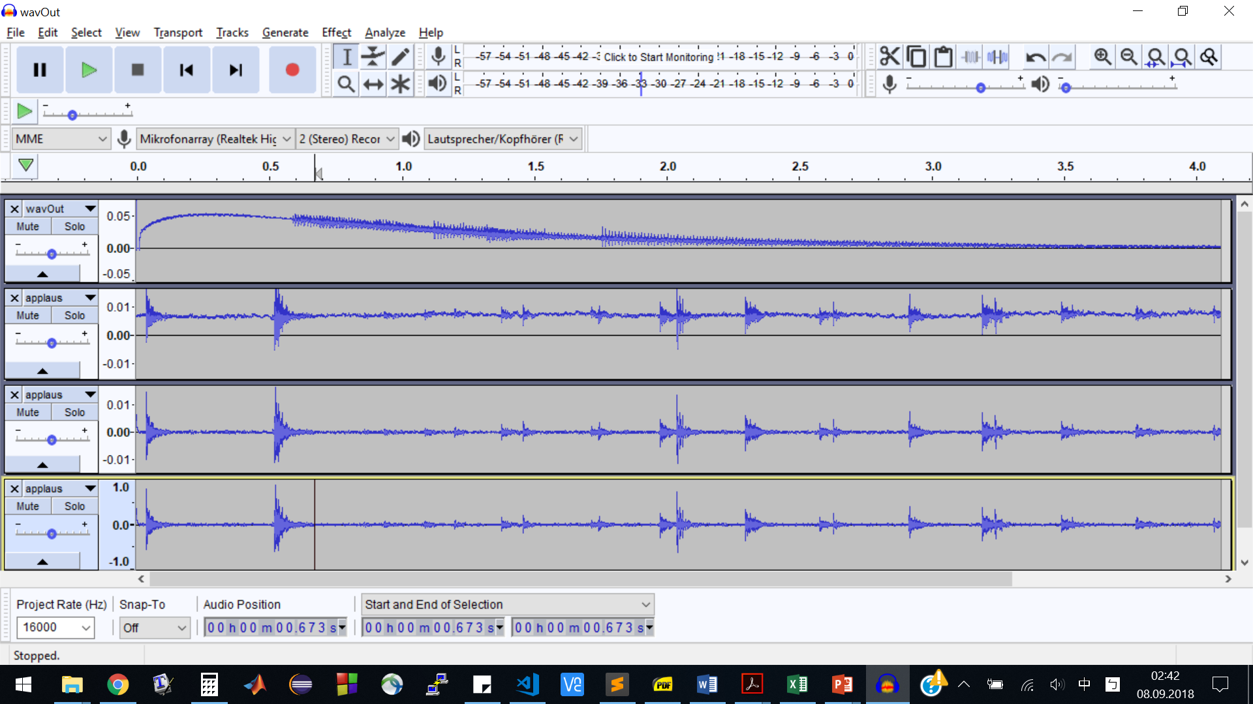
Implementation: Microphone Recording
Amplitude
Non-ideal MEMS Microphone on GAP8
Unstable offset
Too small Scaling
Samples from microphone
time
Windowing
FFT
High Pass & Scaling
Power Spectrum
Filtering (Mel-Scale)
DCT
Normalization
High Pass Filter
→
Scaling
→
Li-Yung Chen
9/21/18
<number>
Notes:
1. Ripple at the beginning
2. After several seconds, offset is still not stable
MFCC algorithm needs adjustment (low frequency bins will become extremely huge)
Implementation and Optimization of BNNs for Embedded Platform and IoT
<number>

Slide 38
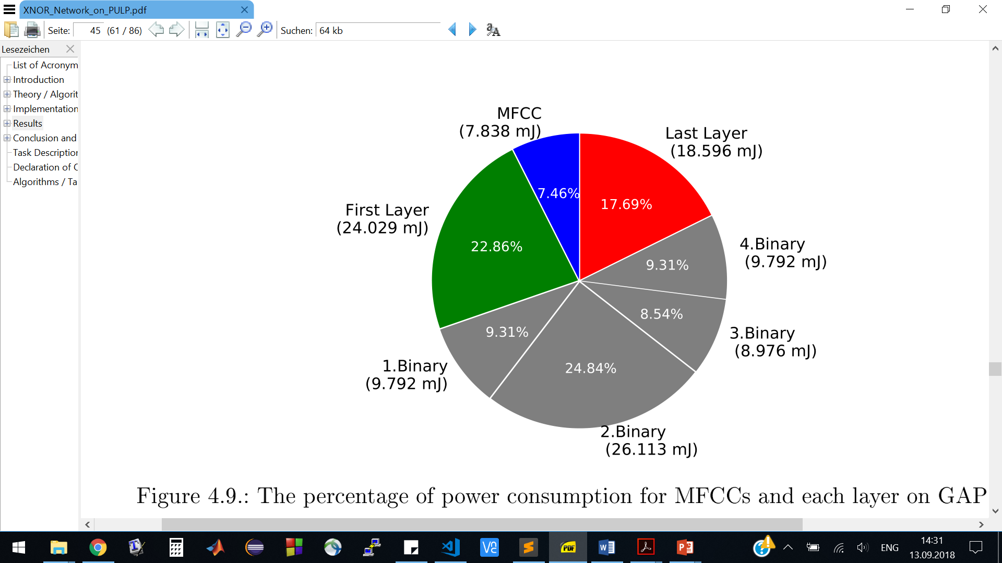
Results
Energy Consumption: GAP8
MFCCs Preprocessing + BNN inference
Total: 105 mJ
GAP8 Processor
Li-Yung Chen
9/21/18
<number>
Notes:
Considering the most optimization:
GAP8: mor efficient on binary layers
CortexM4: efficient on MFCC, first and last layer
Apple with apple please!!
<number>
Implementation and Optimization of BNNs for Embedded Platform and IoT

Slide 39
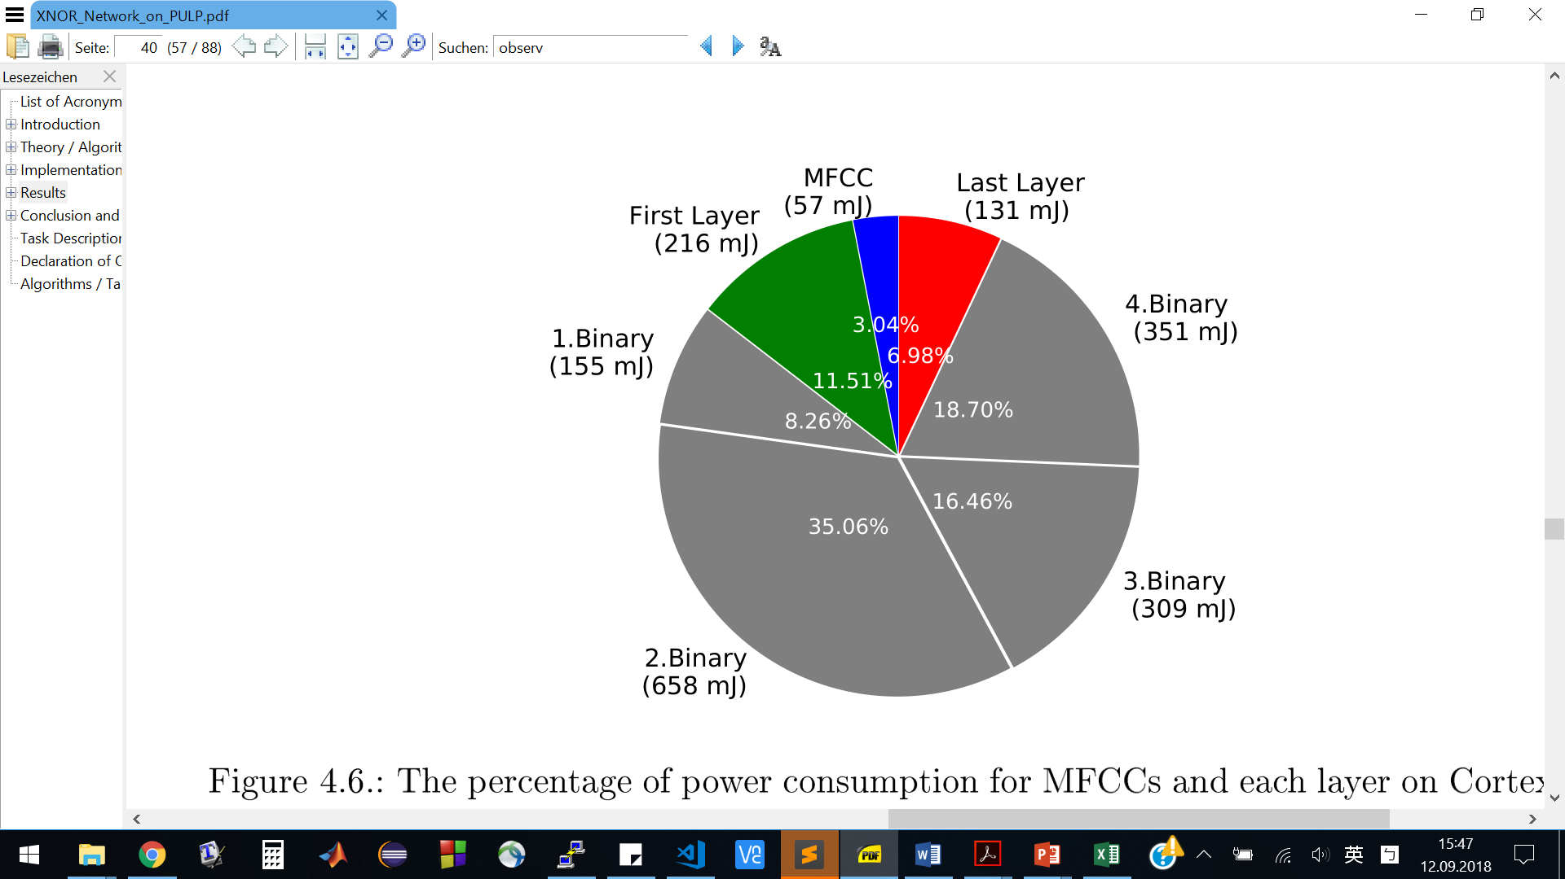
Results
Energy Consumption: ARM
MFCCs Preprocessing + BNN inference
Total: 1877 mJ
Cortex-M4
Li-Yung Chen
9/21/18
<number>
Notes:
Considering the most optimization:
GAP8: mor efficient on binary layers
CortexM4: efficient on MFCC, first and last layer
Apple with apple please!!
<number>
Implementation and Optimization of BNNs for Embedded Platform and IoT

Slide 40
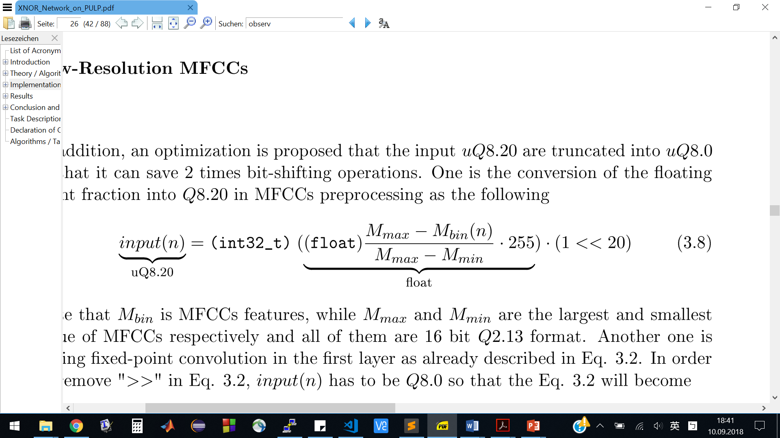
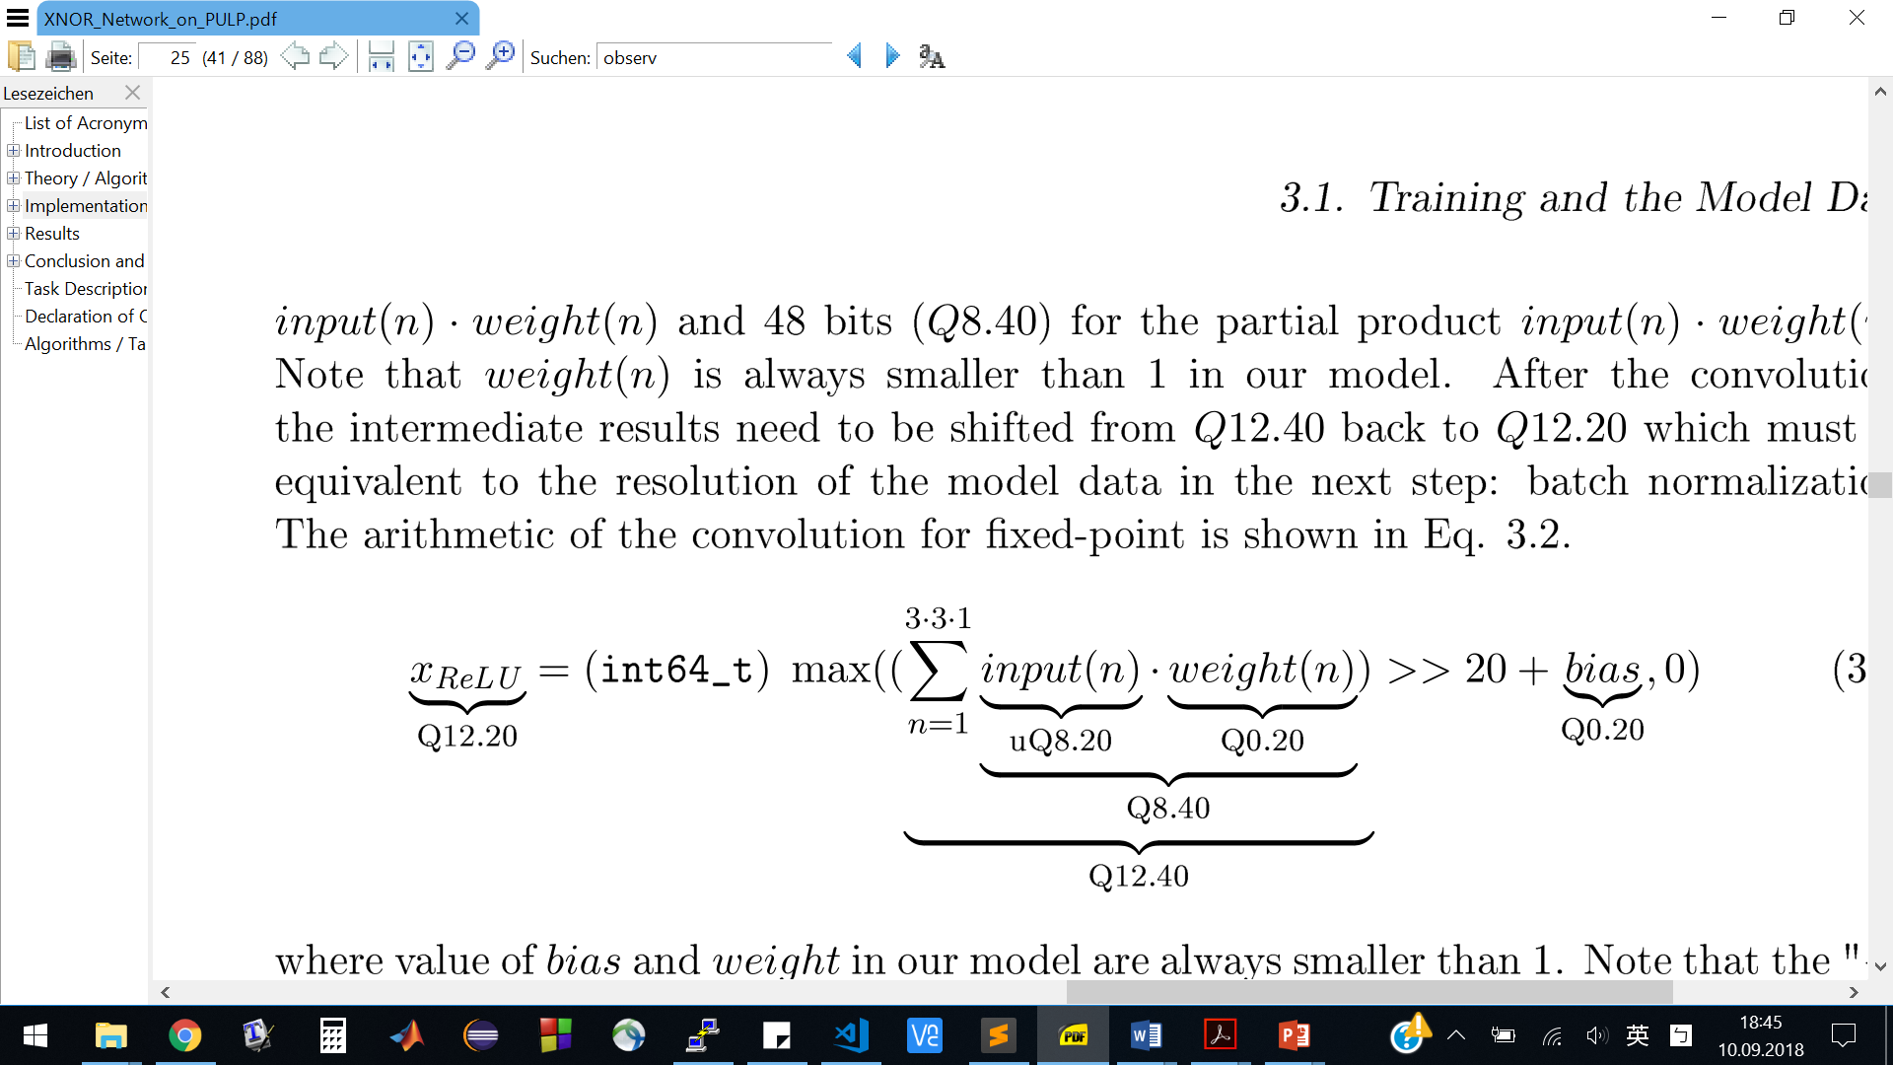
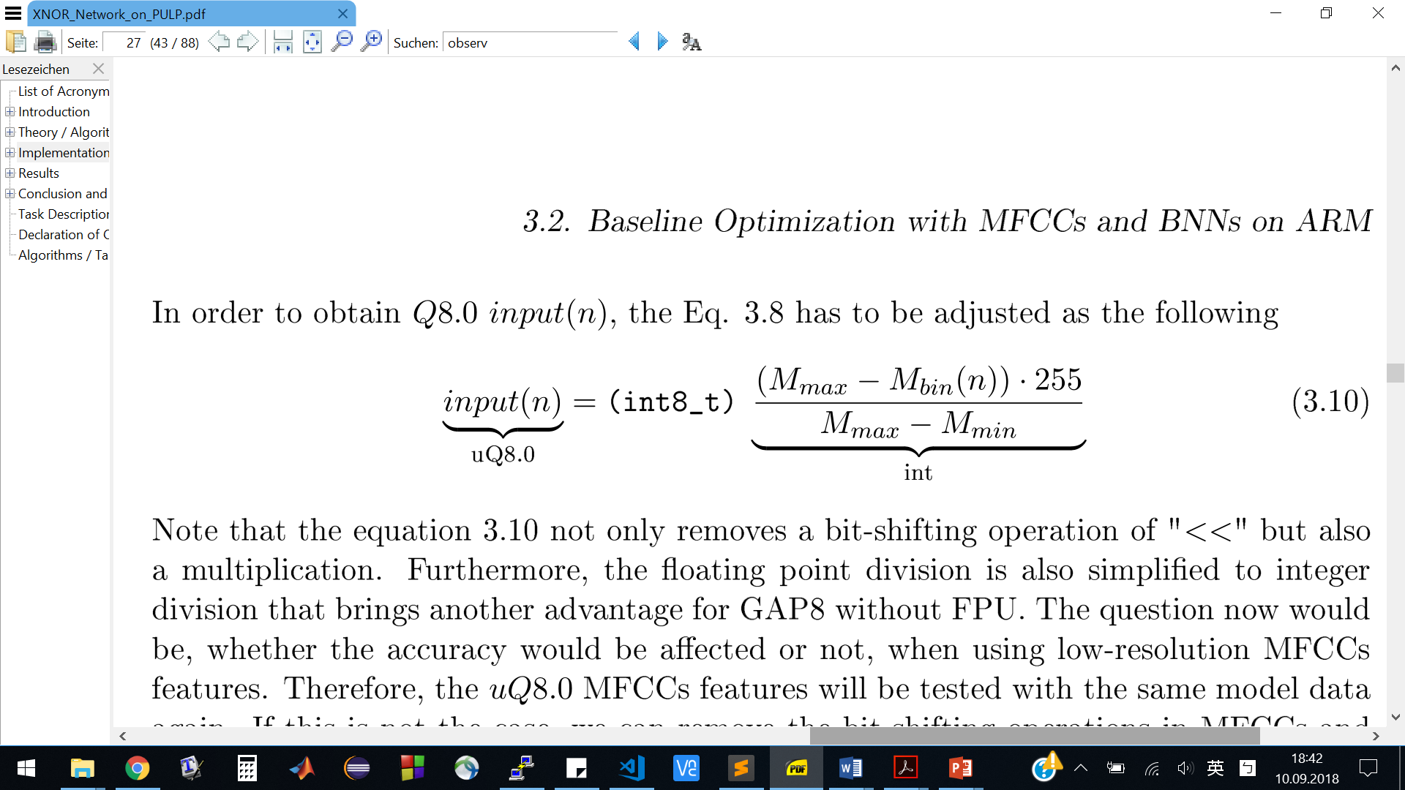
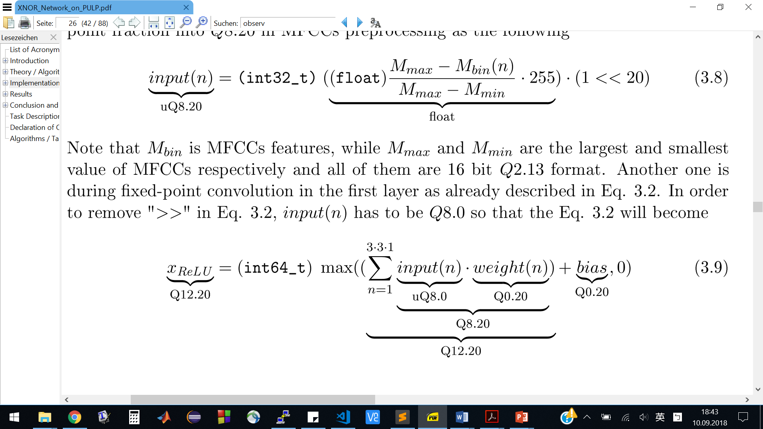
Implementation: Input Preprocessing (MFCC)
Optimization: Low-Resolution MFCCs
Save 1 bit-shifting operations and 1 float multiplication on runtime
→
Li-Yung Chen
9/21/18
<number>
Notes:
Also float division, good for GAP8
Implementation and Optimization of BNNs for Embedded Platform and IoT
<number>

Slide 41
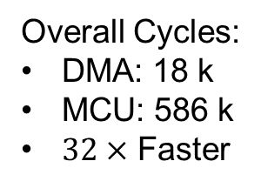
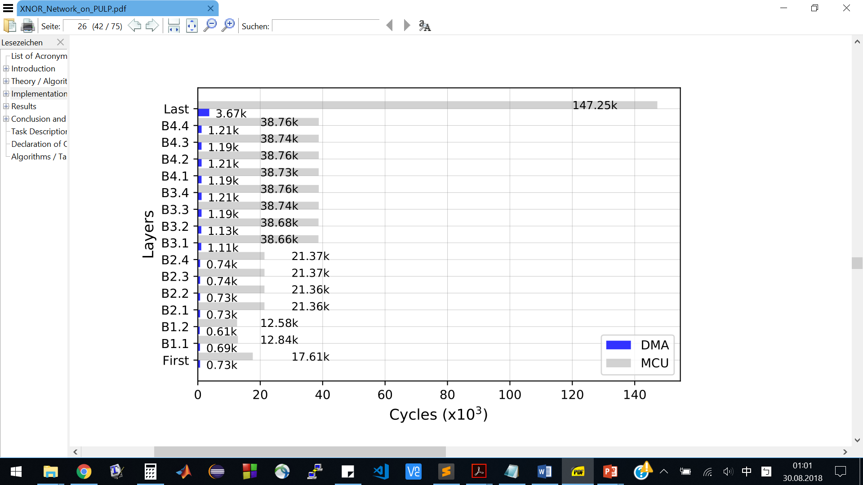
Results
Loading Model from L2-Memory on GAP8
MCU vs. DMA
Overall Cycles:
DMA: 18 k
MCU: 586 k
Faster
Li-Yung Chen
9/21/18
<number>
Notes:
Loading model by MCU or DMA.
Proportional to the size of data.
Mention DMA before!!
<number>
Implementation and Optimization of BNNs for Embedded Platform and IoT

Slide 42
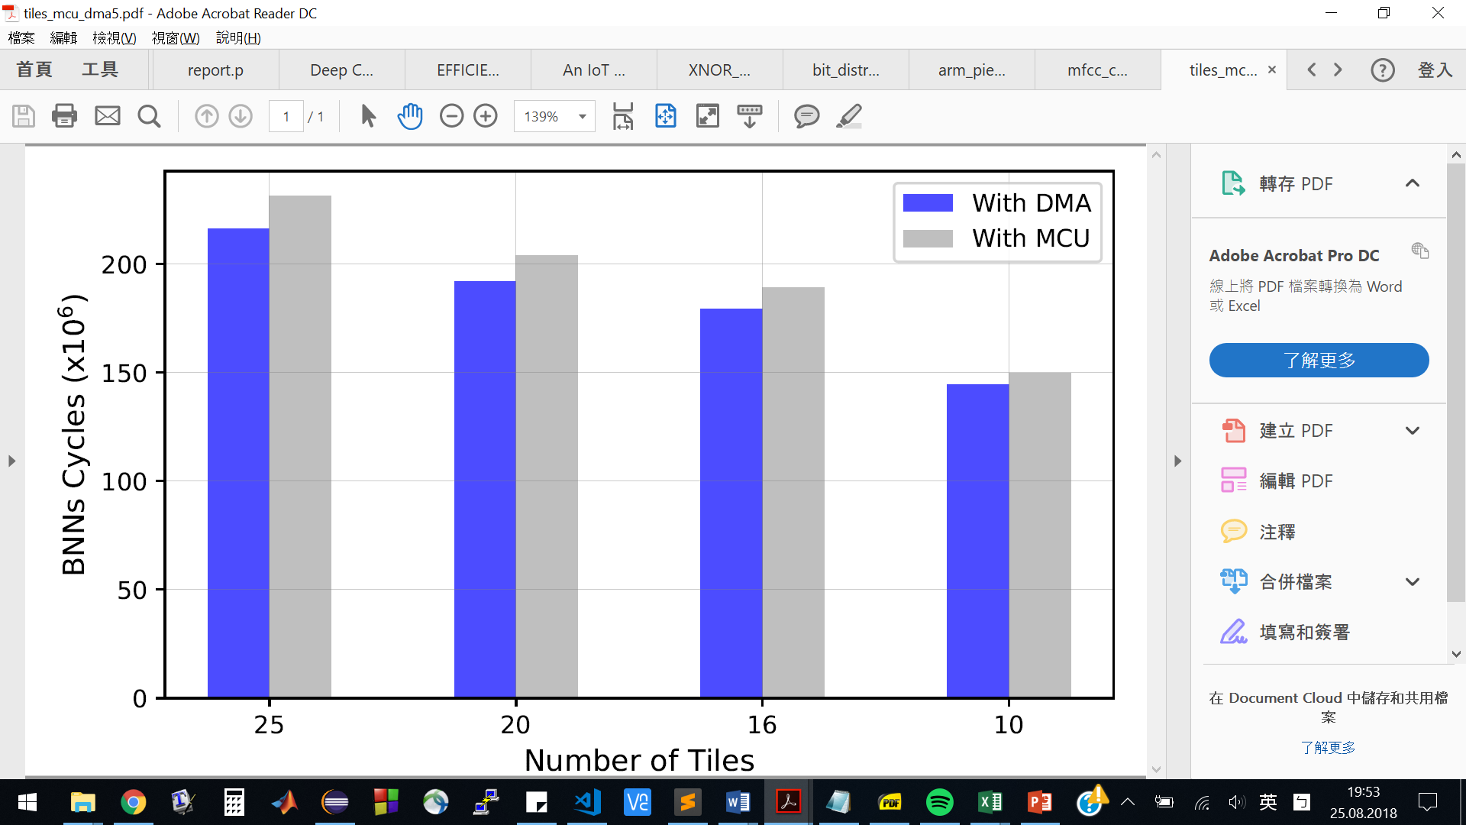
Results
Number of Tiles and Performance
Tiling and overlapping areas
DMA is faster than MCU
L1: 64kB on GAP8
Li-Yung Chen
9/21/18
<number>
Notes:
If no tiling: 100 M cycles are expected
More tiles: more times for loading model data, the
How it is tiled
Overlapping areas cost
<number>
Implementation and Optimization of BNNs for Embedded Platform and IoT

Slide 43
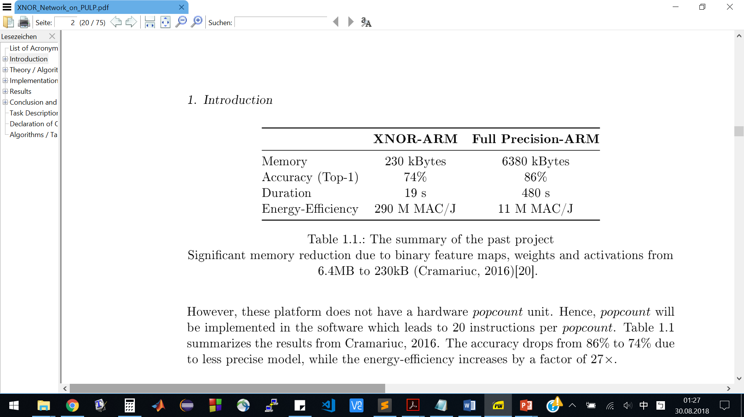
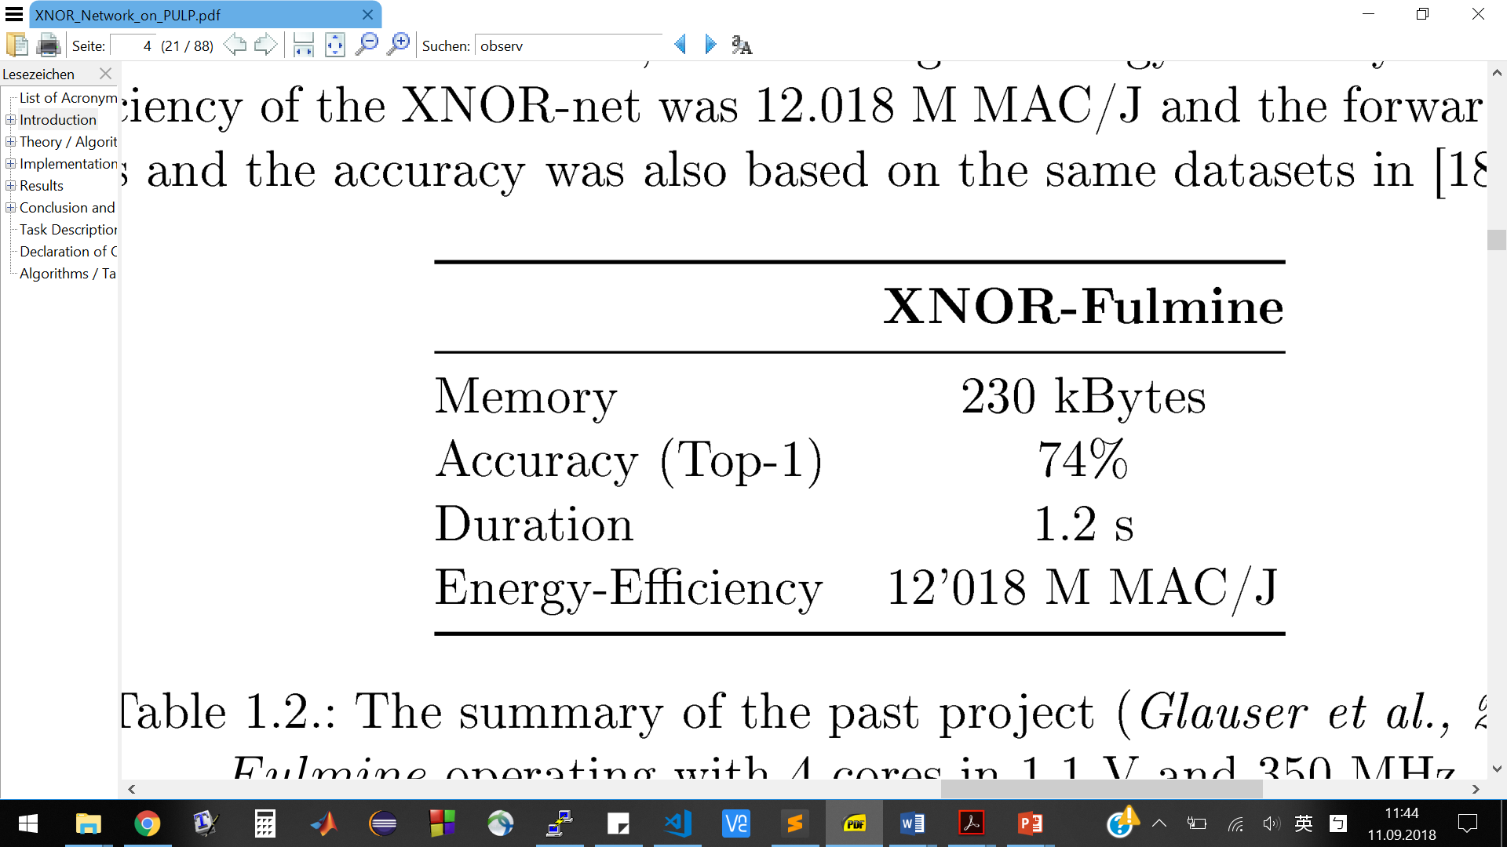
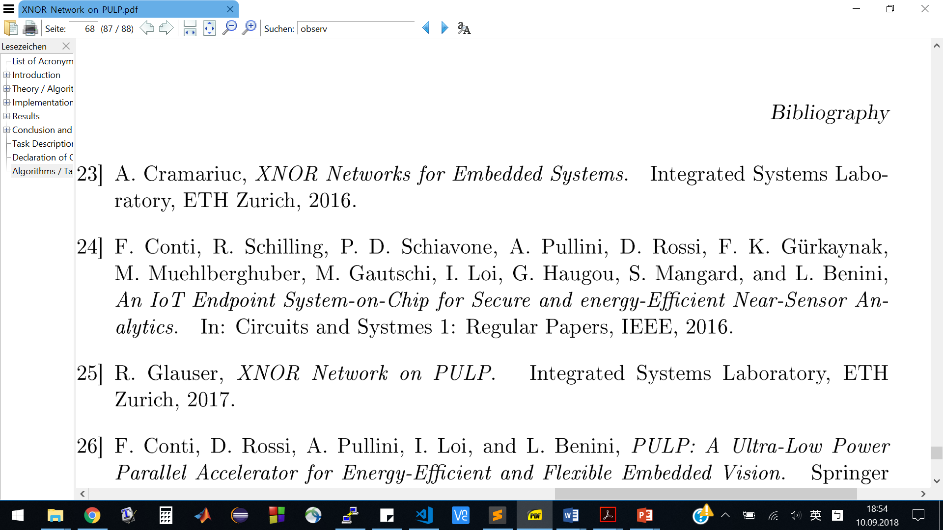
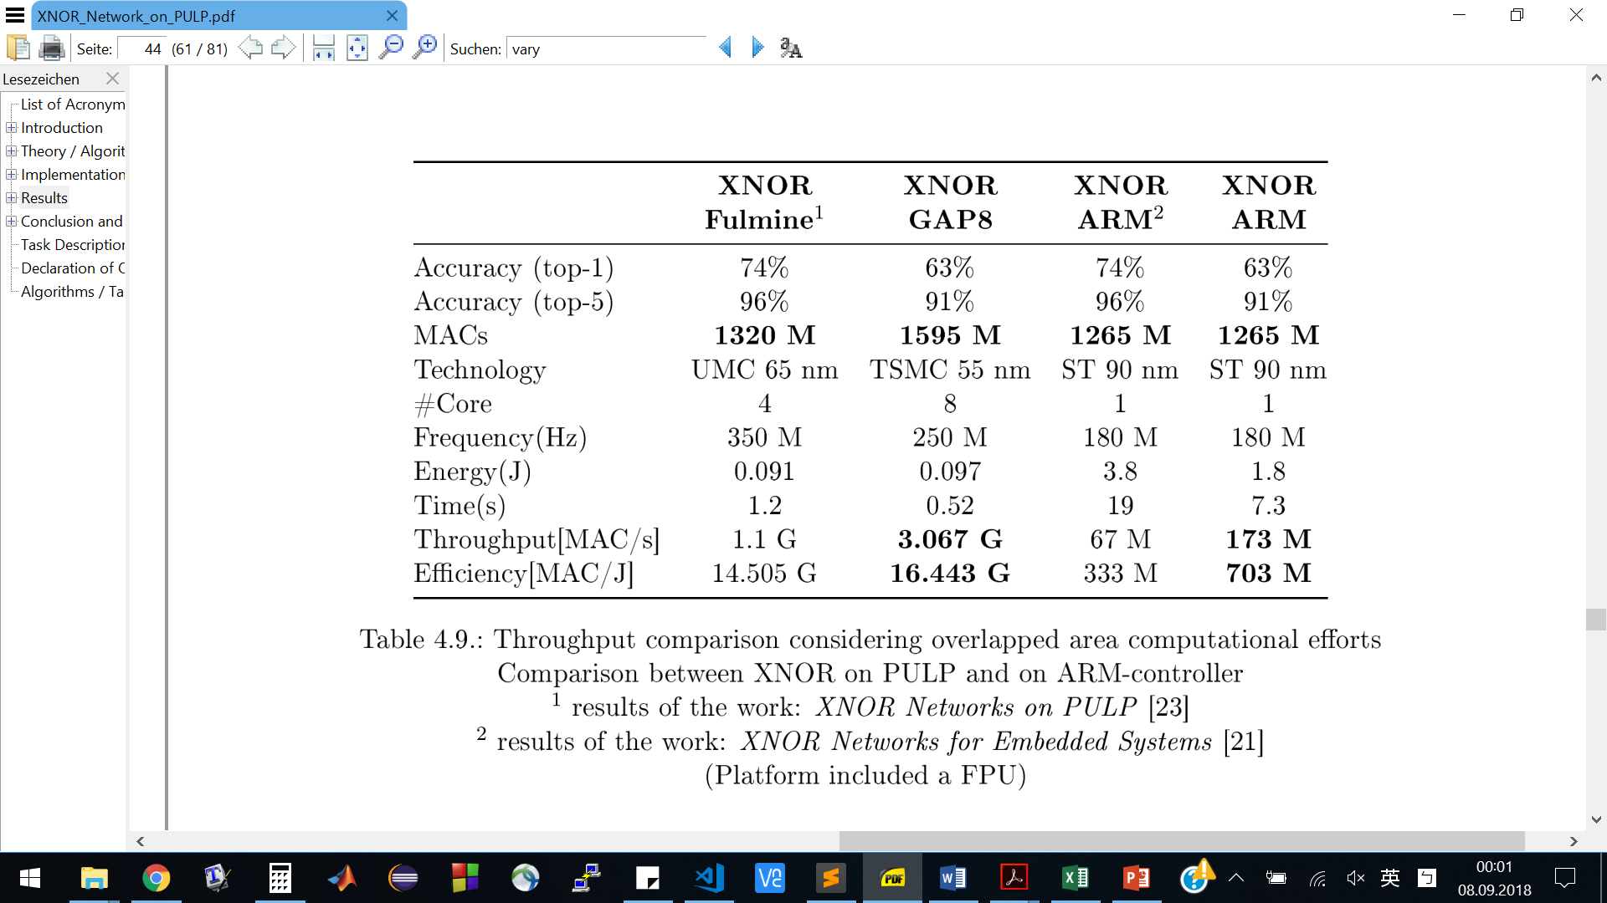
Related Work: Previous Projects
[Mallat, 2012]
Summary of the previos projects
1
1
2
Li-Yung Chen
9/21/18
<number>
Notes:
Not mention number , just said
Implementation and Optimization of BNNs for Embedded Platform and IoT
<number>

Slide 44
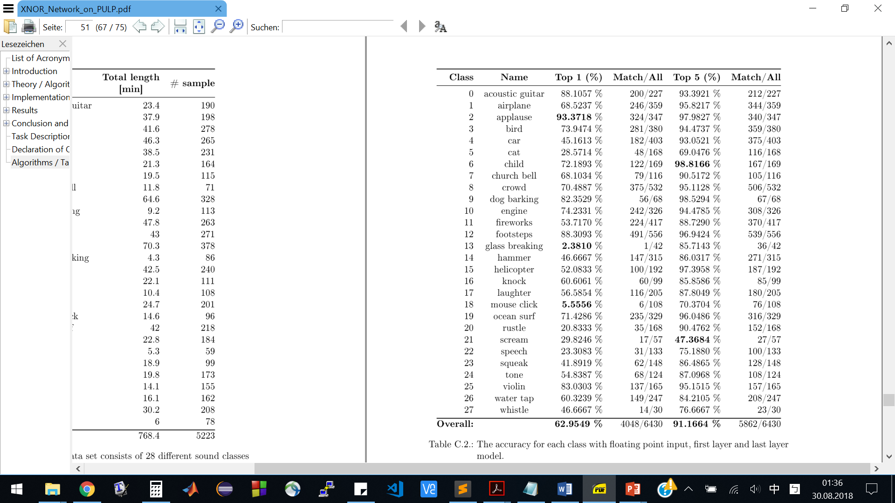
Appendix I : Accuracy of each class (float)
[Mallat, 2012]
Li-Yung Chen
9/21/18
<number>
Notes:
Implementation and Optimization of BNNs for Embedded Platform and IoT
<number>

Slide 45
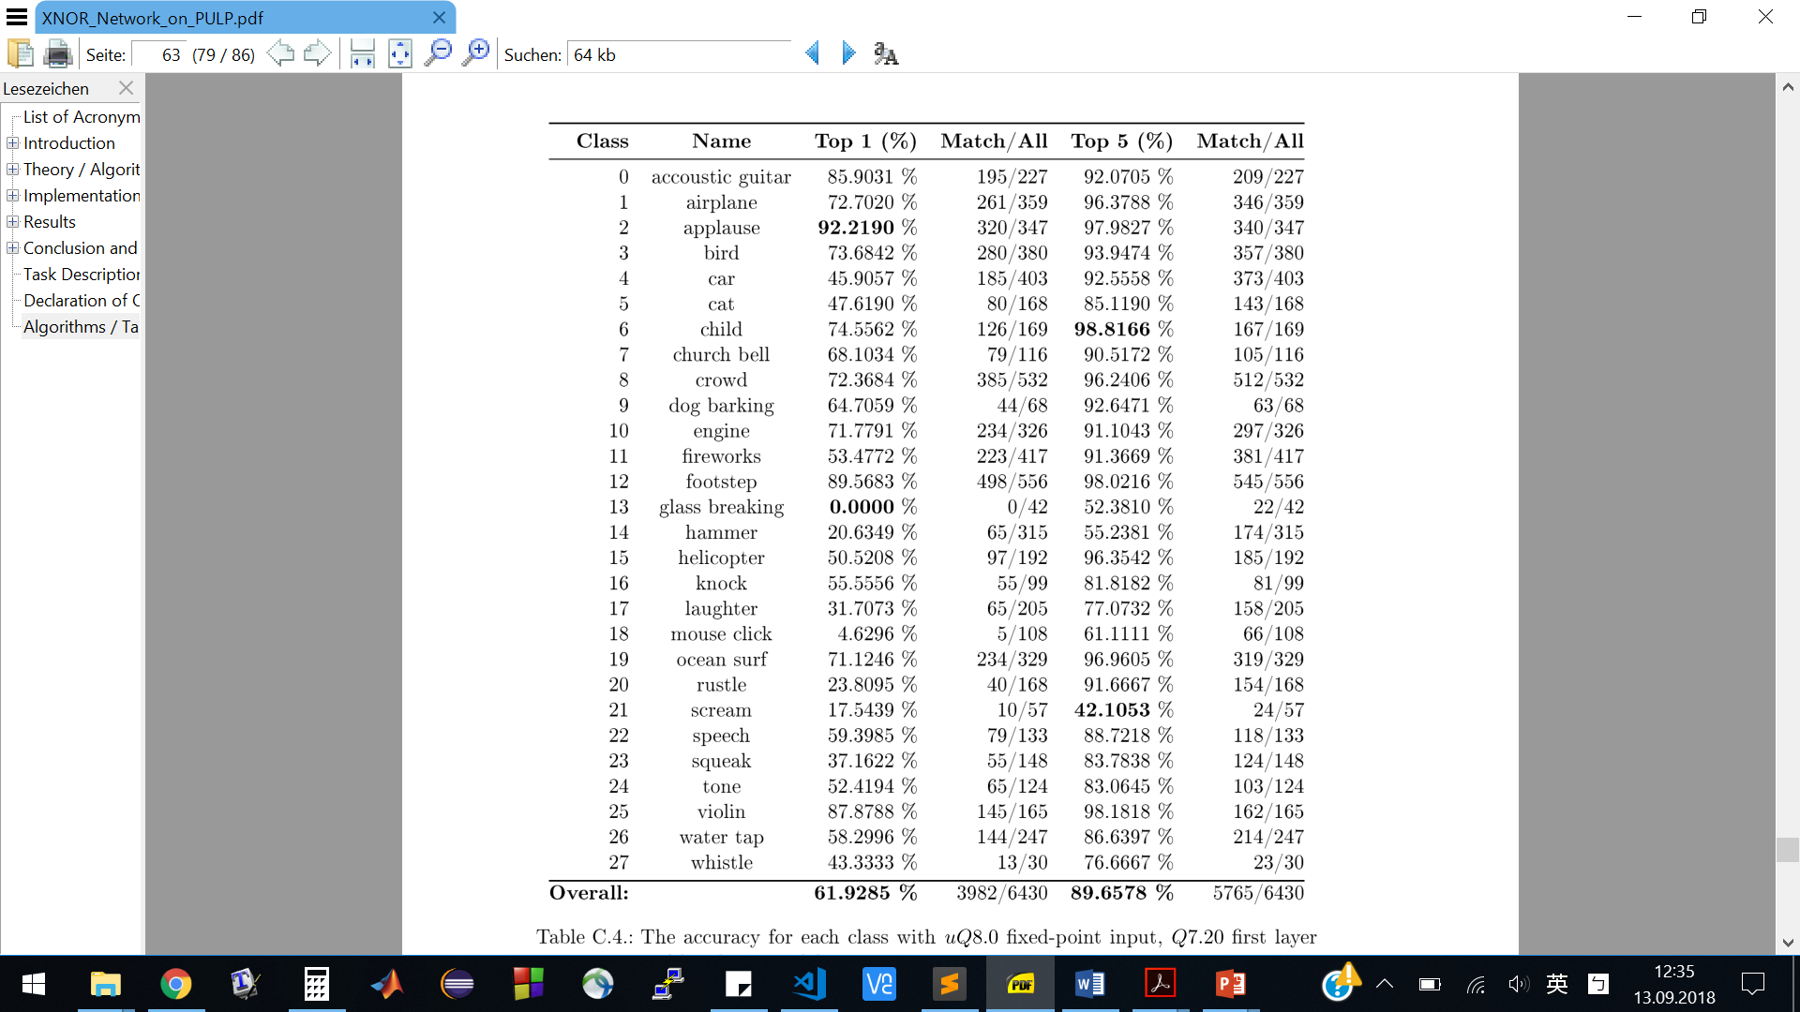
Appendix I : Accuracy of each class (Q8.0)
[Mallat, 2012]
Li-Yung Chen
9/21/18
<number>
Notes:
Implementation and Optimization of BNNs for Embedded Platform and IoT
<number>

Slide 46
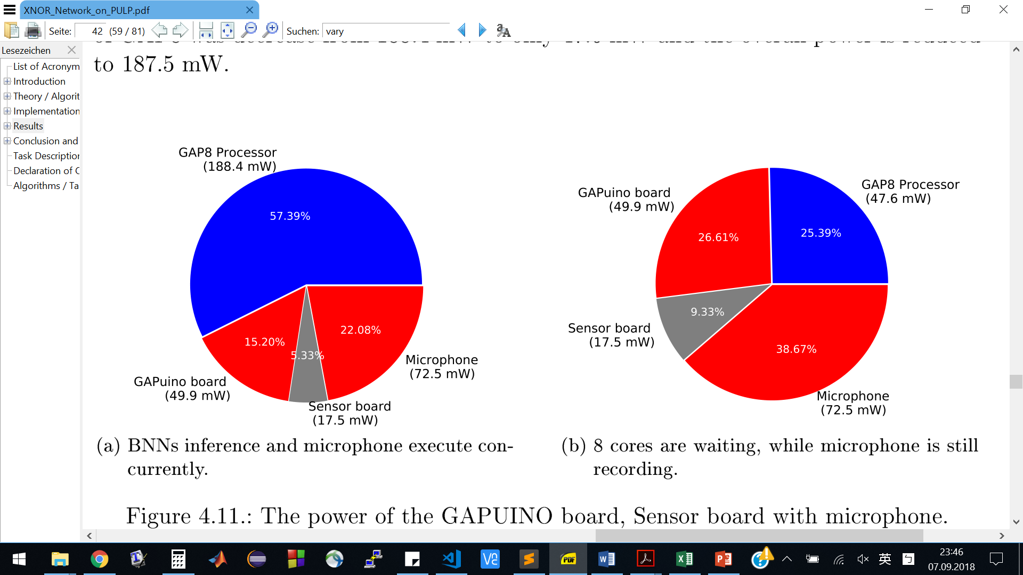
Appendix: Board Power
GAPUINO Board Power
GAP8 vs. Cortex-M4
Total: 328.3 mW
Total: 187.5 mW
BNN inference + recording
Cluster waiting + recording
Li-Yung Chen
9/21/18
<number>
Notes:
During BNN inference, microphone is still recording.
BNN faster → wait for next buffer
Average power: 0.212 W
(may be removed)
<number>
Implementation and Optimization of BNNs for Embedded Platform and IoT

Slide 47
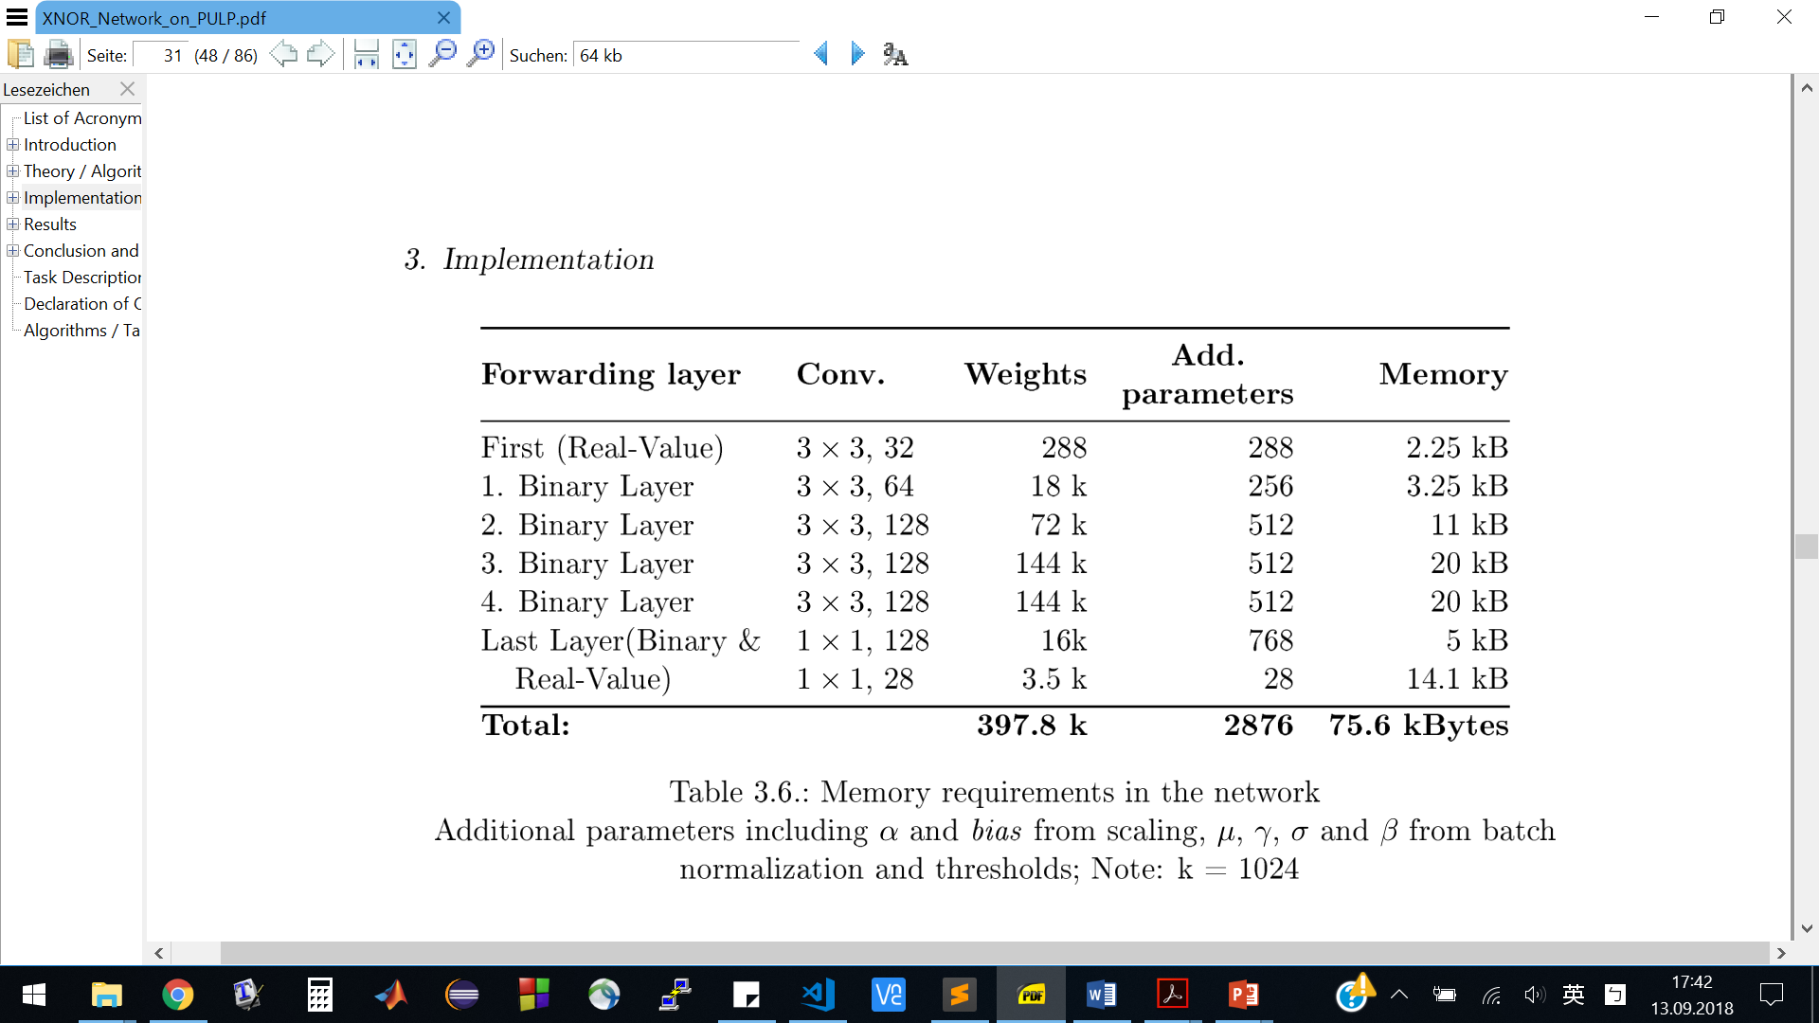
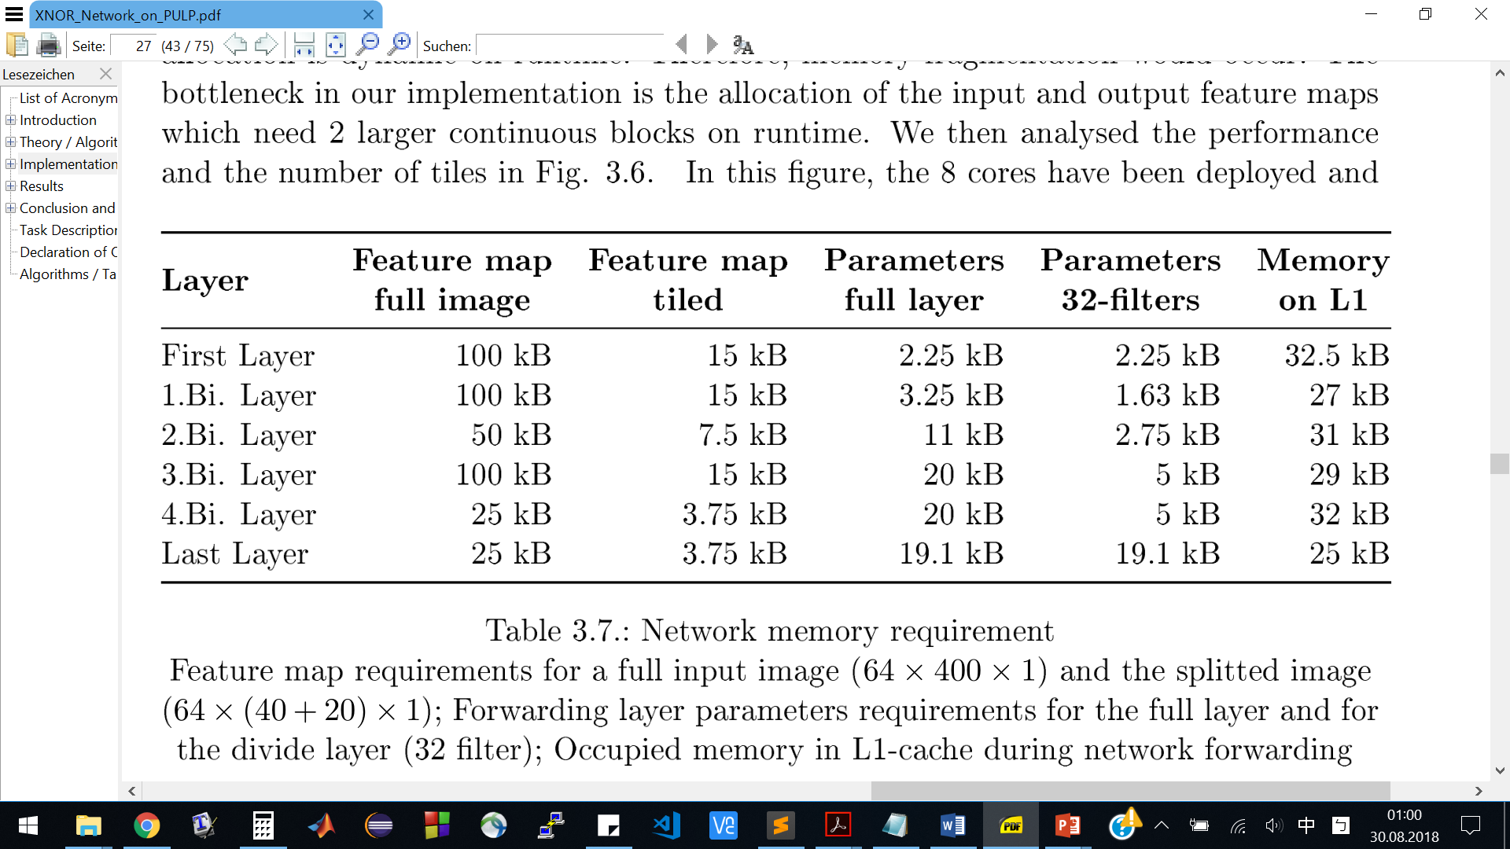
Table
Li-Yung Chen
9/21/18
<number>
Notes:
Bottleneck: dynamic memory allocation,
48 kB are available on runtime.
<number>
Implementation and Optimization of BNNs for Embedded Platform and IoT

Slide 48
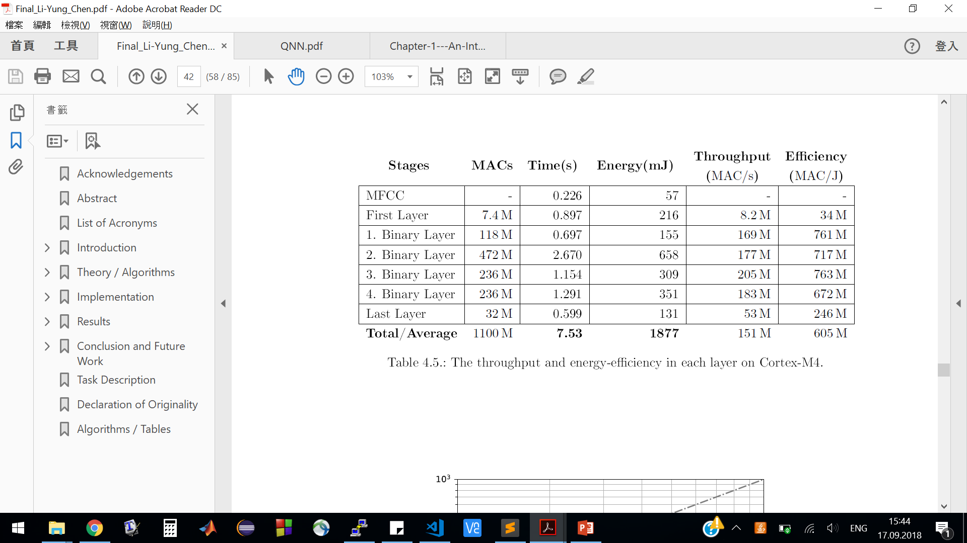
Table
Optimized implementation of BNNs on ARM
Li-Yung Chen
9/21/18
<number>
Notes:
Bottleneck: dynamic memory allocation,
48 kB are available on runtime.
<number>
Implementation and Optimization of BNNs for Embedded Platform and IoT

Slide 49
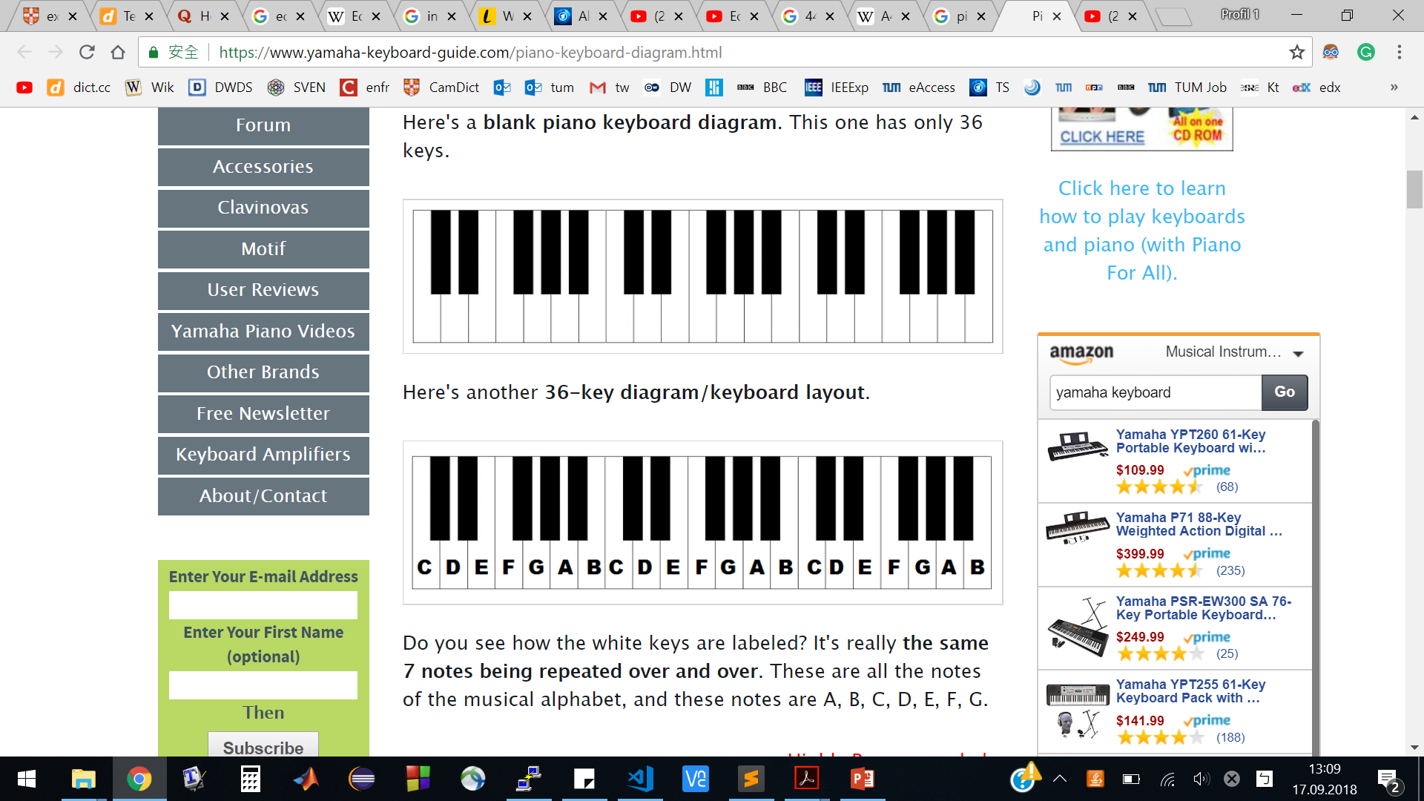
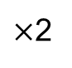
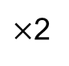
Introduction: Sound Preprocessing (MFCC)
Mel-Frequency Cepstrum Coefficients
Human Auditory System
2
2
Frequency:
440 Hz
880 Hz
1760 Hz
Mel-Frequecny:
548.67
915.86
1413.94
Li-Yung Chen
9/21/18
<number>
Notes:
For deep learning, the most important thing is the number of data and features extraction
Implementation and Optimization of BNNs for Embedded Platform and IoT
<number>

Slide 50

Measurement: GAP8 Progress
Li-Yung Chen
9/21/18
<number>
Notes:
Bottleneck: dynamic memory allocation,
48 kB are available on runtime.
<number>
Implementation and Optimization of BNNs for Embedded Platform and IoT

Slide 51







Appendix: BNN Optimization
=
=
Li-Yung Chen
9/21/18
<number>
Notes:
Bottleneck: dynamic memory allocation,
48 kB are available on runtime.
<number>
Implementation and Optimization of BNNs for Embedded Platform and IoT

Slide 52

Results
Compared to previous projects
Li-Yung Chen
9/21/18
<number>
Notes:
2.3x faster Fulmine
tiles, 5, 10, 4, 4
Accuracy: different MFCCs features
<number>
Implementation and Optimization of BNNs for Embedded Platform and IoT

